Slide 1
The Extended Liquidity Facility (ELF): the next step in the SNB’s liquidity support to banks
Antoine Martin
Vice Chairman of the Governing Board Swiss National Bank
International Center for Monetary and Banking Studies Geneva, 29 April 2025

Slide 2
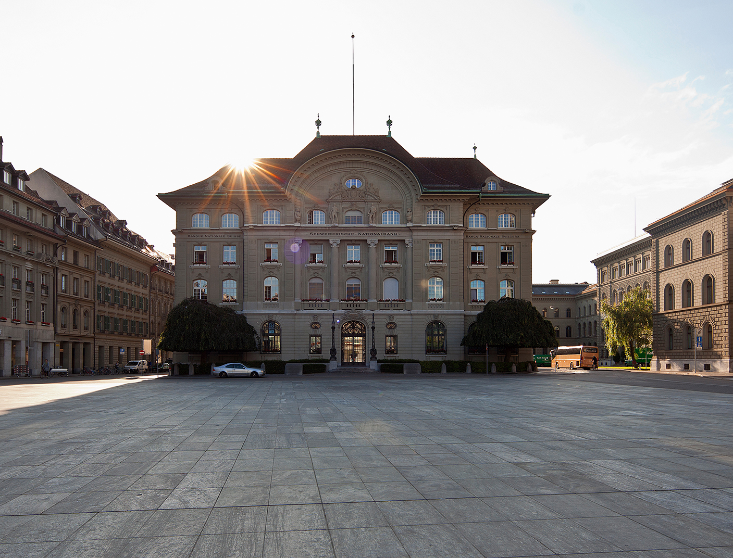

Agenda
01
The Evolution of the SNB’s role as LOLR
02
The new Extended Liquidity Facility (ELF)
Picture: © KEYSTONE SDA / Gaetan Bally
03
Recommendations on liquidity regulation

Slide 3
The evolution of the SNB’s role as lender of last resort (LOLR)
1800s
1906
1990s
2003
SNB founded with implicit LOLR role
Emergency Liquidity Assistance (ELA) framework introduced
LOLR theory (Thornton, Bagehot)
Shift towards ‘constructive clarity’

Slide 4
Emergency Liquidity Assistance (ELA) framework
Conditions
Extensions
ELA
 | Systemically important banks
Mortgages | 2004
Securities | 2015
All banks
2023 (announced)
2024 (announced)
Solvent banks
Sufficient collateral
Banks or groups of banks relevant for financial system stability

Slide 5
Emergency Liquidity Assistance (ELA) framework
Conditions
Extensions
ELA
 | Systemically important banks
Mortgages | 2004
Securities | 2015
All banks
2023 (announced)
2024 (announced)
Solvent banks
Sufficient collateral
Banks or groups of banks relevant for financial system stability

Slide 6
The Extended Liquidity Facility (ELF): conditions and design
Conditions
Design
ELF
Process similar to ELA (solvency confirmation by FINMA, decision by SNB Governing Board)
Solvent banks
Sufficient collateral
Predefined limit
Simplified access

Slide 7
The Extended Liquidity Facility: motivation
Ease of access
Over-reliance

Slide 8


The Extended Liquidity Facility: broad collateral framework
Eligible collateral
Mortgages
Securities
Residential properties
Commercial properties
Bonds
Securitisations
Shares in various currencies

Slide 9
Looking ahead: implementing the ELF and beyond
1800s
1906
1990s
2003
Today
SNB founded with implicit LOLR role
Emergency Liquidity Assistance (ELA) framework introduced
LOLR theory (Thornton, Bagehot)
Shift towards ‘constructive clarity’
Introducing
ELF and PSSF

Slide 10
Looking ahead: implementing the ELF and beyond
1800s
1906
1990s
2003
Today
SNB founded with implicit LOLR role
Emergency Liquidity Assistance (ELA) framework introduced
LOLR theory (Thornton, Bagehot)
Shift towards ‘constructive clarity’
Introducing
ELF and PSSF

Slide 11



Strengthening banks’ resilience to liquidity risks
SNB

Slide 12
Strengthening banks’ resilience to liquidity risks
3rd line of defence: Anchoring the PLB in law
2nd line of defence: Introducing a minimum collateral requirement
SNB
1st line of defence: Increasing banks’ own liquidity provisions

Slide 13
Strengthening banks’ resilience to liquidity risks
3rd line of defence: Anchoring the PLB in law
1st line of defence: Increasing banks’ own liquidity provisions
2nd line of defence: Introducing a minimum collateral requirement
SNB

Slide 14
Strengthening banks’ resilience to liquidity risks
1st line of defence: Increasing banks’ own liquidity provisions
2nd line of defence: Introducing a minimum collateral requirement
3rd line of defence: Anchoring the PLB in law
SNB

Slide 15
Take-aways
Liquidity support to banks is of
the utmost importance to SNB –
the ELF is the next step
01
Picture: © KEYSTONE SDA / Gaetan Bally
Continued collaboration between authorities and banks necessary
02

