Slide 1
the digitalization of money
Jean-Pierre Landau – November 2019

Slide 2
John Oliver (American comedian – 2018)
"Crypto- currencies are everything you don't understand about money combined with everything you don't understand about computers"

Slide 3
a wave of monetary innovations : crypto currencies, Libra
that go beyond improvements in payments. Sometimes, new currencies : medium of exchange, stores of value, unit of account
meet some of our aspirations : instant, peer to peer, cross border transactions

Slide 4
digital money : networks + tokens
digital networks : protocols operating on the internet. Commercial, social, monetary -money as part of a "bundle" of services and a source of data -Antfinancial, Wechat, Libra
digital tokens :
electronic files with names and value attached ; cryptographic keys
similarities to physical tokens (banknotes) : peer to peer; anonymous
need for ledgers (centralized or decentralized)
adapted to transactions in digital world
account based vs token based money

Slide 5
changes to financial intermediation
will private monies succeed in the digital environment ?
reshaping the International Monetary System
implications for Central Banks and monetary policy ?

Slide 6
I. Changes to financial intermediation
life without a bank : possible, not certain
the preeminence of payments in financial intermediation

Slide 7
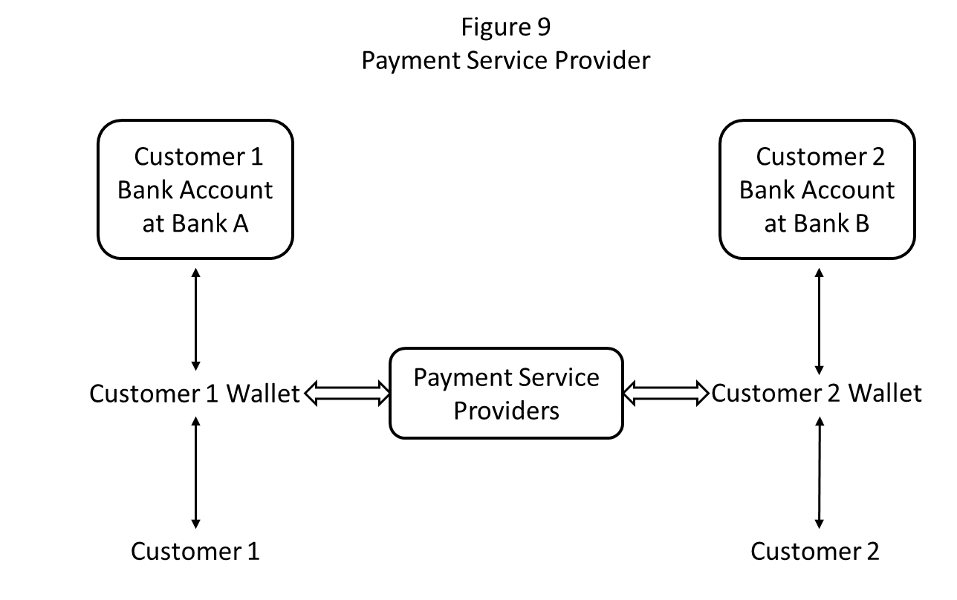
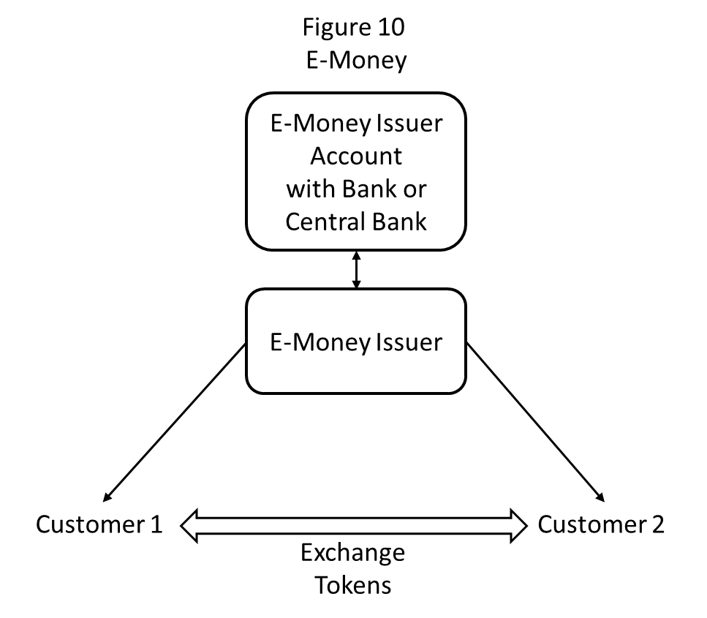
life without a bank : possible not certain
wallet
e-money - "stable coins"

Slide 8
life without a bank : possible, not certain
e - money / stable coins combined with Apps offer that possibility
competition between debit / credit cards and mobile phones
Impact of "fast payment" systems ?
cross border operations – the vanishing correspondent banking relationships
social attitudes and preferences
the regulatory environment of e - money : a major and immediate challenge

Slide 9
the preeminence of payments
Digitalization may lead to an inversion industrial organization of financial intermediation :
from a "bank centric" model
to a "payment centric" model

Slide 10
From bank centric……
customer
customer
BANK
other
services
payments

Slide 11
….to payment centric
customer
PAYMENT PLATFORM
customer
Asset Management
BANK

Slide 12
II. private digital currencies ?
digitalization helps private medium of exchange
network effects and immediate acceptability
switching costs are lower
over issuance trust and algorithms
digitalization allows creation of new units of accounts
digitalization does not help private stores of values
demand driven by expectations and risk appetite
backing needed
difficult for a private issuer
the attraction of "stable coins"

Slide 13
III. reshaping the International Monetary System ?
Digital Currency Areas
kept together by digital interconnectedness
use existing or new unit of account
cross border or domestic
Digital Dollarization
what is an international money : medium of exchange or store of value
if the former, digitalization is a way to internationalization
New international (synthetic) Digital Currencies ?

Slide 14
IV . public money and monetary policy
an old concern : will technology eliminate the need and demand for Central Bank money
has been proved unfounded : Central Bank money in RTGS and as ultimate liquid and safe assets. Monetary policy conducted by interest on reserves
more fundamental argument by Woodford : money defined as the liability of the Central Bank and Central bank controls its interest rate
assumes that the Unit of Account is defined and accepted by the public

Slide 15
the unit of account and uniform currency
the disappearance of cash, the only public money for the general public
a diversification in the forms of money
a segmentation of monetary systems
is there still a uniform currency ?
what happens to the Unit of Account ?
authorities can act (legal tender, paying taxes) but "financial repression" ?

Slide 16
Digital Central Banks Currencies (CBDCs)
two (in my view) accessory debates :
circumventing the zero lower bound
implications for financial stability
one essential argument : keep Central Bank money in the hands of the general public. Preserve a "uniform currency" and the Unit of Account
CBDC in token form : e-cash, no interest, a complement and not substitute to bank deposits. The question of anonymity

Slide 17
thank you

Slide 18
references
Brunnermeier, Markus K., Harold James and Jean-Pierre Landau : The Digitalization of Money NBER Working Paper 26300 – September 2019
Brunnermeier, Markus K., Harold James and Jean-Pierre Landau : Digital Currency Areas . Vox EU, July 13, 2019
Landau, Jean-Pierre with Alban Genais : Digital Currencies - A report to the French Minister of Economy
https://www.economie.gouv.fr/files/files/2019/ENG-synthese-ra-crypto-monnaies-180705.pdf
Landau, Jean-Pierre : Private and Public Digital Money (forthcoming)

