Slide 1
Sovereign risk and the sustainability of the euro
21 November 2017
Lorenzo Bini Smaghi

Slide 2
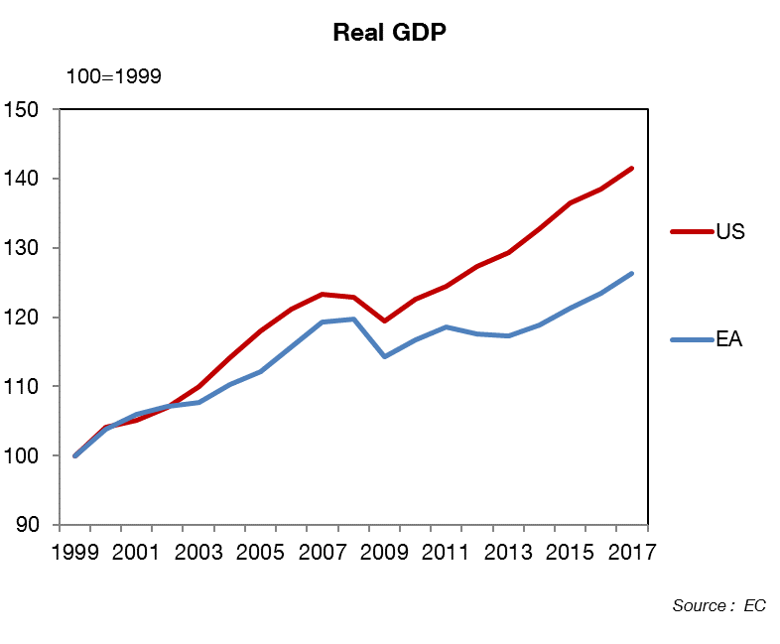
THE EURO AREA FALLING BEHIND
Notes:
The underperformance of the Eurozone appears important in terms of pure GDP level
NB: Chart updated and includes new EC forecasts.

Slide 3
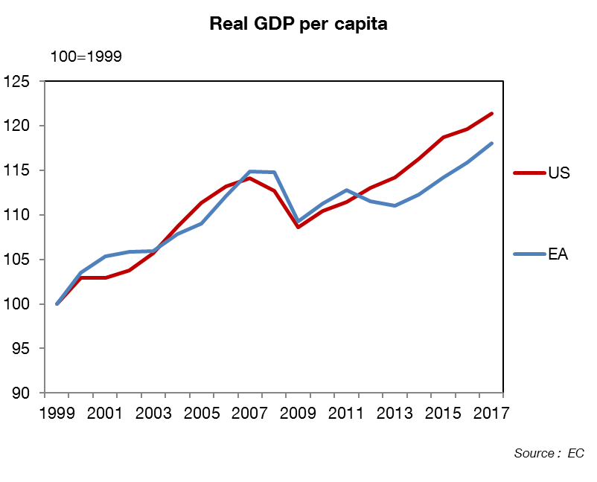
ONLY AFTER 2011
Notes:
But in per capita terms, the underperformance of the Eurozone is the sole consequence of the Eurozone crisis of 2010-2013.
NB: Chart updated and includes new EC forecasts.

Slide 4
FISCAL AUSTERITY?

Slide 5
MONETARY POLICY?

Slide 6
MONETARY POLICY?

Slide 7
INTEREST RATES AND GROWTH

Slide 8
INTEREST RATES AND GROWTH

Slide 9
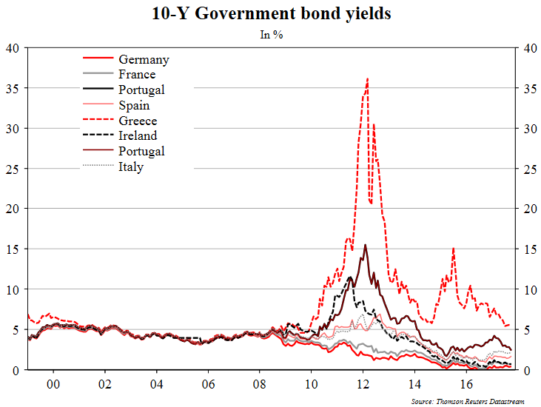
THE SOVEREIGN DEBT CRISIS
Notes:
The Eurozone crisis seems to be a pure sovereign crisis at first sight.
The loss of GDP/capita relative to the USA was triggered by a massive and sudden loss of confidence of investors in sovereign debt, in many eurozone banking systems and in the euro itself at the worst of the crisis.
1999-2007: Myopia: The decline of the “home bias” / Huge capital flows
In parallel: growing imbalances within EZ countries (indebtedness, current account deficits, housing price…)
Financial integration appeared not resilient to shocks (cross-border financing mainly based on short-term interbank debt, bank lending to unproductive sectors as construction)
2010-2012: Hyper-reaction: skyrocketing spreads. Vicious triangle: Sovereign debt crisis/banking crisis/balance of payment crisis
2012-2017: the set of solutions to solve (at least temporarily) each aspect: SMP/ OMT/ LTRO / EFSF/ESM / More credible fiscal oversight… QE?
What is in the spreads now?
Redenomination risks: largely reduced thanks to ECB measures
Market fragmentation: Still present. The role of hysteresis: investors and banks that quit a market are slow to come back. As long as fragmentation remains, liquidity premium will remain too.
Credit risk: Broad reduction of public deficits, but wide divergences in debt levels and prospects.
Beyond ECB measures, what do we want in spreads?:
Liquidity and credit risks (market discipline)
No redenomination risk, no impact of fragmentation
During this presentation we will highlights needed change to sustain sovereign spreads and then the euro. Around three eras: need of risk reduction, need of risk sharing, need to built efficient market discipline.

Slide 10
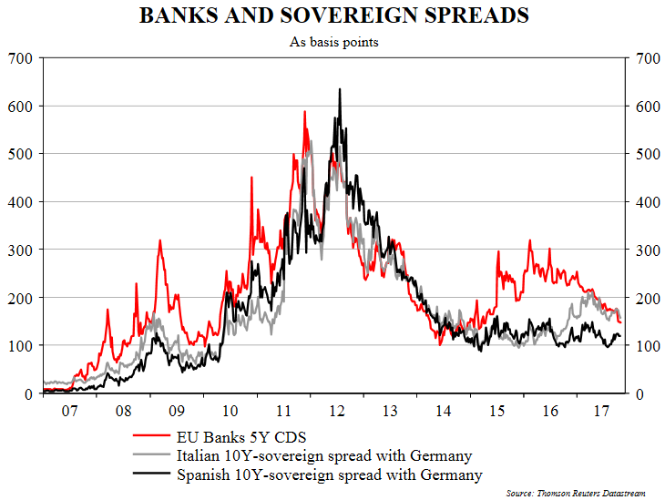
THE DOOM-LOOP BANKS/SOVEREIGNS
Notes:
But the fact is that it was also a banking crisis in some cases (Spain, Ireland) with a negative loop between sovereigns and banks.
The problem goes beyond the simple “banking crisis” or “sovereign crisis” debate.
The main “pain” factor in the EZ crisis was eventually that investors started to understand that the Eurozone institutional framework would not allow a State/country to deal with its banking or sovereign debt problems in a manner that would not cause utter chaos in the real economy.
Hence, investors started to expect a risk of euro exit (redenomination risk).
So in the end, the Eurozone crisis is above all a redenomination risk issue.

Slide 11
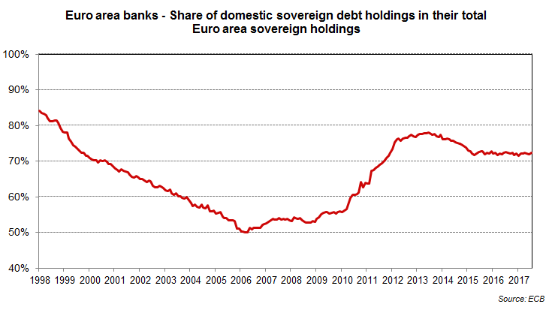
BANKS’ HOME BIAS
P.10
Notes:
The perverse doom loop has not been produced by the existing high stock of Government bonds in banks’ balance sheets.
In fact, banks have increased their exposure to domestic public debt during the crisis, instead of diversifying risk.
Why?
Home bias
ALM
Moral suasion

Slide 12
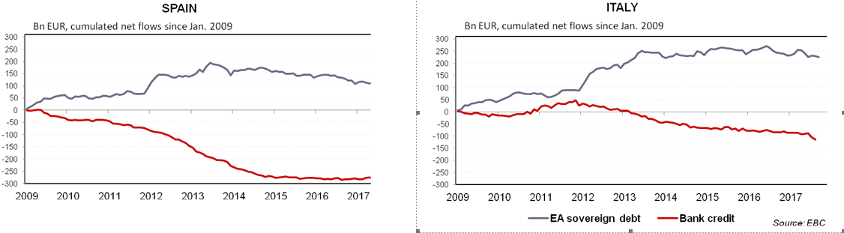
THE DOOM LOOP RESTRICTED CREDIT
P.11
Notes:
Banks’ increase in their domestic debt holdings has been accompanied by a fall in credit to the economy.
What is the causality?
Recession has led banks to reduce credit and use the extra liquidity (and the VLTRO) to invest in Government bonds (portfolio effect)
Higher returns on domestic government bonds has pushed banks to allocate their balance sheet towards Government bonds (crowding out)
Probably a mix of the two. Home bias has increased.

Slide 13
A BANKING CRISIS

Slide 14
REDENOMINATION RISK IS KEY, AND HAS NOT BEEN SOLVED
P.13
Notes:
Widening TARGET 2 balances are a clue to show that redenomination risk is a major problem. Balances rise in 2011-12, and then. Fall after the “whatever it takes”, but then start rising again.
TARGET balances are NOT the problem, they are a marker (although quite hidden) of the problem (i.e. investors not feeling confident enough to invest in each EZ country). ECB suggests that this is the result of the Asset Purchase Program (eg the Banca d’Italia buys Italian Government bonds from a German bank). However, QE is changing the portfolio composition of banks, adding to home bias.

Slide 15
EMU REFORM
Public debt sustainability
Answer so far:
- European semester
- Fiscal Compact
- ESM
Answer so far:
- OMT
- TARGET2
Sovereign / bank loop
Answer so far:
- Banking union (incomplete)
Redenomi-nation risk
P.14
Notes:
In the end, the EZ is confronted to 3 separate problems which can, as we said, be linked to the most important issue: redenomination risk.
Some answers have been proposed for each issue so far, although it remains insufficient overall.
A few of the missing elements :
On public debt sustainability:
- Compliance with the rules
- Sizable EZ fiscal capacity
On redenomination risk:
- Sizable EZ fiscal capacity
Automatic OMT and adjustment programme
On Sovereign-Bank loop:
- NPL reduction
- True European supervisor
-Pan-Eurozone banks
We will look at how insufficient the answers so far have been (i.e. remaining problems).

Slide 16
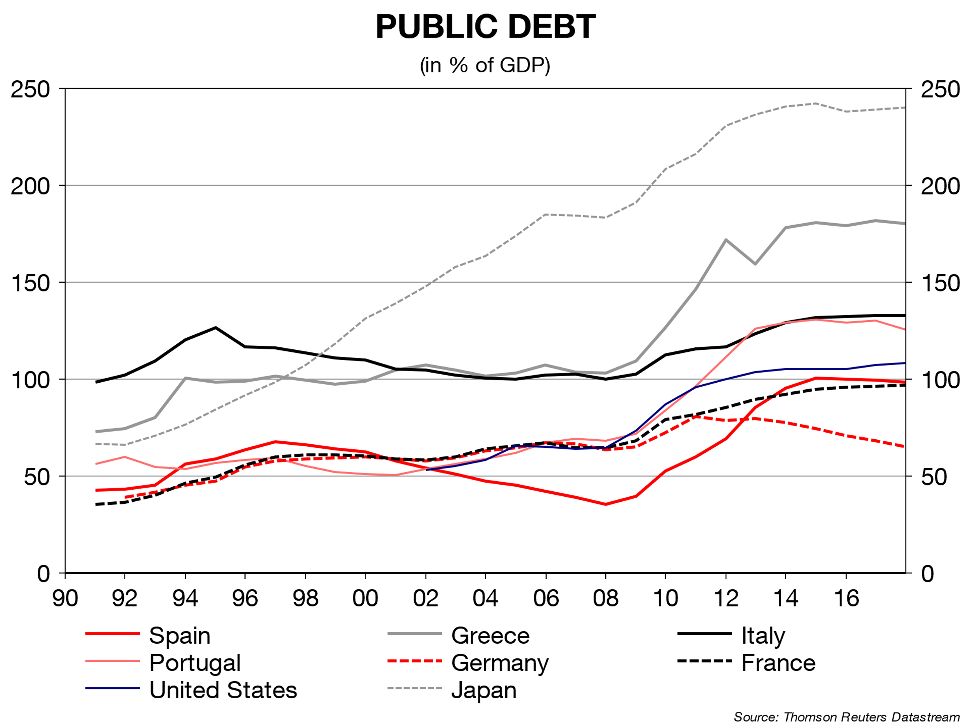
PUBLIC DEBT: AN ISSUE, BUT NOT TO BE OVERESTIMATED
P.15
Notes:
First remaining problem: debt sustainability with no prospect for quick public debt reduction (as the EZ crisis showed, severe austerity doesn’t lead to much improved public finances when monetary policy can’t react to limit the impact on activity).
However, is this really worse than other advanced countries?

Slide 17
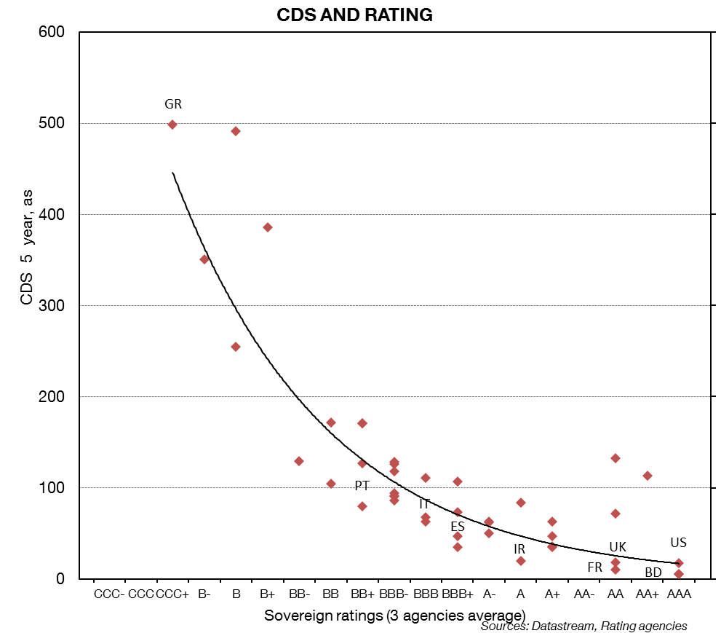
THANKS TO THE ECB?
Investors pricing rating downgrades
Investors pricing rating upgrades
P.16
Notes:
ECB QE is weighing on spreads, with EZ CDS spreads being below “normal” for similarly-rated countries.
This chart shows the link between sovereign CDS spreads and the average rating for about 50 countries, both developed and emerging. We see that Eurozone countries and especially peripheral countries (Greece excepted) benefit from low spreads relative to their rating.

Slide 18
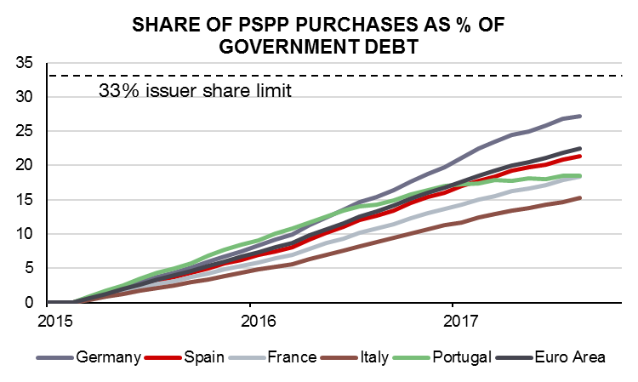
BUT THERE ARE LIMITS TO THE ECB’S POLICIES
P.17
Notes:
ECB QE has allowed to dampen most of the most obvious tensions on periphery countries financing (visible in lower sovereign spreads).
The question of pricing of redenomination risk and of periphery financing is going to be more acute when ECB purchases will stop.
Most of all, the large and growing footprint of the ECB on sovereign debt markets puts effective limits on potential OMT purchases if and when needed.
Hence, OMT is less and less credible.

Slide 19
THE ECB IS CLOSE TO ITS LIMITS
P.18
Notes:
The ECB would be hard pressed to act if needed

Slide 20
BANKS ARE STILL DOMESTIC
P.19
Notes:
… and increasing their exposure to their own sovereign (for periphery banks).
One can note that despite integration from 1999 to 2007, home bias was still at play in 2007. It has (re)accentuated since then with a significant increase of public debt holdings in some countries

Slide 21
WHAT SHOULD BE DONE?
Risk reduction
Market discipline
Risk sharing
P.20
Notes:
What should be done?
The EUROPEAN COMMISSION proposed in October a roadmap on 6 points, which was self-styled as “pragmatic”, but seems to push back in time some key elements of risk sharing, due to extended transition periods and a focus on risk reduction (unbalanced approach).
Six axis in the roadmap
Actions to address to NPLs
Moving forward to EDIS with EDRIS as an interim
Completing a backstop to the Banking Union
An enabling framework for development of Sovereign Bond-Backed Securities (SBBS)
Continuing to ensure high quality supervision
Risk reduction through the November 2016 Banking package
Let’s look each of the 3 elements in more detail, with a focus on some key proposals by the European Commission or by other key players.

Slide 22
WHAT SHOULD BE DONE? – RISK REDUCTION
Risk reduction
European Semester
Tackling NPLs
Genuine single regulator
P.21
Notes:
European Semester
Poor compliance with the rules. National efforts to strengthen public finances and implement structural reform should be in the interest of all parties, but encounter serious political headwinds due to potential short-term costs and perceived distributional effects.
Tackling NPLs
Several key players today focus on risk reduction, i.e. dealing with banks legacy problems.
A European Strategy for NPLs (Council adopted action plan on 11-Jul-2017)
Banking supervision
Statutory prudential backstops to address under-provisioning of new NPLs
Observations:
Provisioning must avoid pro-cyclicality and take proper account of risk (for example, not all mortgages are identical)
A level playing field for ALL banks is key both in terms of financial stability and competitiveness.
Reform of insolvency and debt recovery frameworks
Commission proposal for a Directive on Insolvency, Restructuring and Second Chance (22.Nov.2016)
Observations:
A consistent framework is a pre-requisite to a single European secondary market for NPLs. Taxation must also be considered.
Secondary market for NPLs (Public consultation from 10-Jul to 20-Oct-2017)
A proposal for an “accelerated loan security” to allow secured creditors to recover value swiftly (out-of-court power to foreclose collateral). (Indicative planning - 1Q18.)
Observations:
Harmonised legislation and enhanced standardised disclosure requirements are key pre-requisites. Taxation must also be considered.
A common legal framework for collateral reinforcement would be welcome.
European blueprint for national AMCs (Commission proposal of 11-Oct-2017)
Observations:
National Asset Management Companies (AMCs) are helpful, but may fail to break the sovereign-bank doom loop.
A European (AMC) would be welcome; this will need a public backstop and should not result in extra charges on banks.
On NPLs Harmonisation of insolvency regimes, development of liquid secondary markets, enhanced supervision, EU-wide AMC … are welcome. Provisioning must avoid pro-cyclicality. Stress tests must be credible and cost-effective.
Genuine single regulator
Remove the risk of geographical ring-fencing and moral suasion. Ensure a level playing field and cost-efficiency. Bolster the development of CMU.
But risk reduction will never be enough nor considered accomplished.
Demands for risk reduction will be unending as at any given time, a country in the EZ will be faced with a specific shock (for example, Brexit could have much higher impact on some countries).
In this case, the fragilized country would still have much difficulty to adjust given the currency union regime, which would lead to redenomination risks resurfacing.
In the USA, this is not an issue as there are mechanisms to ease the pain of adjustment (Federal transfers) while safeguards are in place to ensure adhesion to common rules (especially on banking).
In the end, risk sharing has to be offered with risk reduction.

Slide 23
WHAT SHOULD BE DONE? RISK SHARING
Risk sharing
European deposit insurance scheme (EDIS)
Common fiscal backstop for the Single Resolution Fund (SRF)
Fiscal transfer mechanism
SBBS versus true Eurobonds (blue part)
Capital Market Union
P.22
Notes:
In terms of risk sharing, there are two broad categories :
those regarding banking topics and
those specifically on public finances,
There is currently a deadlock on the first category, because of demands for additional risk reduction measures as a preliminary step.
The second category is being solely discussed in a longer-term view.
On EDIS, the mechanism initially proposed was a progressive mutualization, thus a true risk sharing. This should not be pushed back in time as we saw earlier.
An idea could be to extend an ESM backstop to EDIS.
Indeed, fears of cost to taxpayer can easily be alleviated even with a fiscal backstop, if the legislation foresees that the deposit guarantee scheme has first priority in a bank resolution, with the remainder of the cost being contributed by the rest of the financial system.
This is the case in the US with the FDIC.
In the Savings and Loans crisis and in 2008-2010, the FDIC had to tap its credit line to the US Treasury, but paid back the money eventually.
Fiscal transfers (in the framework of a countercyclical instrument, like an unemployment insurance for example), would also alleviate the pressure on the real economy and on public finances in countries subject to an asymmetric shock.
Important to note that C. Wyplosz is not especially optimistic on a Eurozone/EU unemployment benefit as he considers that it doesn’t offer anything new to citizens. Here, the point is to protect national public finances, not to propose something new to citizens.
Again, this is a mechanism in place in the USA, through several Federal social programs.
On Eurobonds, The European Commission proposals advocated a “pragmatic” approach with Sovereign Bonds Backs Securities (SBBS), a securitization mechanism proposed by the European Systemic Risk Board.
However, there are several problems with SBBS:
-Pooling and tranching does not reduce risks; it merely reshuffles it.
-SBBS may damage liquidity in national government bond markets.
-Tranching may increase the cost of debt for lower rated sovereigns (higher perceived risk of restructuring).
-The ability of the ECB to still conduct QE effectively may be impacted depending on what conditionality it attached.
-Re-introducing peripheral sovereign risks to core bank balance sheets would increase contagion risks.
Genuine Eurobonds need to offer risk-sharing (“joint and several liability”).
The idea of Blue/Red bonds looks promising, even though politically very sensitive.
At least, “blue bonds” (the part of debt below 60% of GDP) would offer a true Euro Area wide risk-free security.

Slide 24
WHAT SHOULD BE DONE? MARKET DISCIPLINE
Market discipline
Diversification of banks euro area government bond portfolios
Eurobonds (Red part)
Sovereign debt restructuring
P.23
Notes:
Diversification of banks euro area government bond portfolios
No official proposal, although increasing risk weights on sovereign exposures is often put forward.
Indeed, the remaining problem of Home bias and sovereign/bank loop is often presented as a simple consequence of inadequate regulation. However, it is inherent to the construction of nation-based banking systems.
Making sense of home bias and large bank exposures to the domestic sovereign:
The usual suspect: 0 risk weight on EU sovereign exposures (for banks under standard method) or at least to their domestic sovereign (for banks under Internal Rating Based – IRB – method).
For periphery banks, risk/returns favour holding domestic positions.
For core banks, what is preventing a rush to higher-yielding periphery bonds?
Possible capital costs for banks under IRB approach for badly rated countries.
Increased volatility of P&L (for mark-to-market exposures) or Other Comprehensive income (for AFS exposures) if periphery markets are more volatile.
Financial communication issues: stigma linked to the past, investment in countries where the banks makes no or little business…
Hence, even changing regulation on sovereign risk weights is unlikely to affect significantly and durably the banks’ investment decisions
A lasting solution: Pan-Eurozone banks and CMU
Would require legislation change and perfect mobility of banks’ capital and cash within the Eurozone, not subject to national supervisors.
Sovereign debt market discipline
Several key players today focus on risk reduction, i.e. dealing with legacy problems.
Market discipline is often referenced in the literature and is theoretically very appealing.
In practice, financial markets, however, tend to overshoot and undershoot and are highly pro-cyclical.
ESM/OMT rely on a very strong ex-ante assumption of debt sustainability and thus any crisis is only a matter of liquidity.

Slide 25
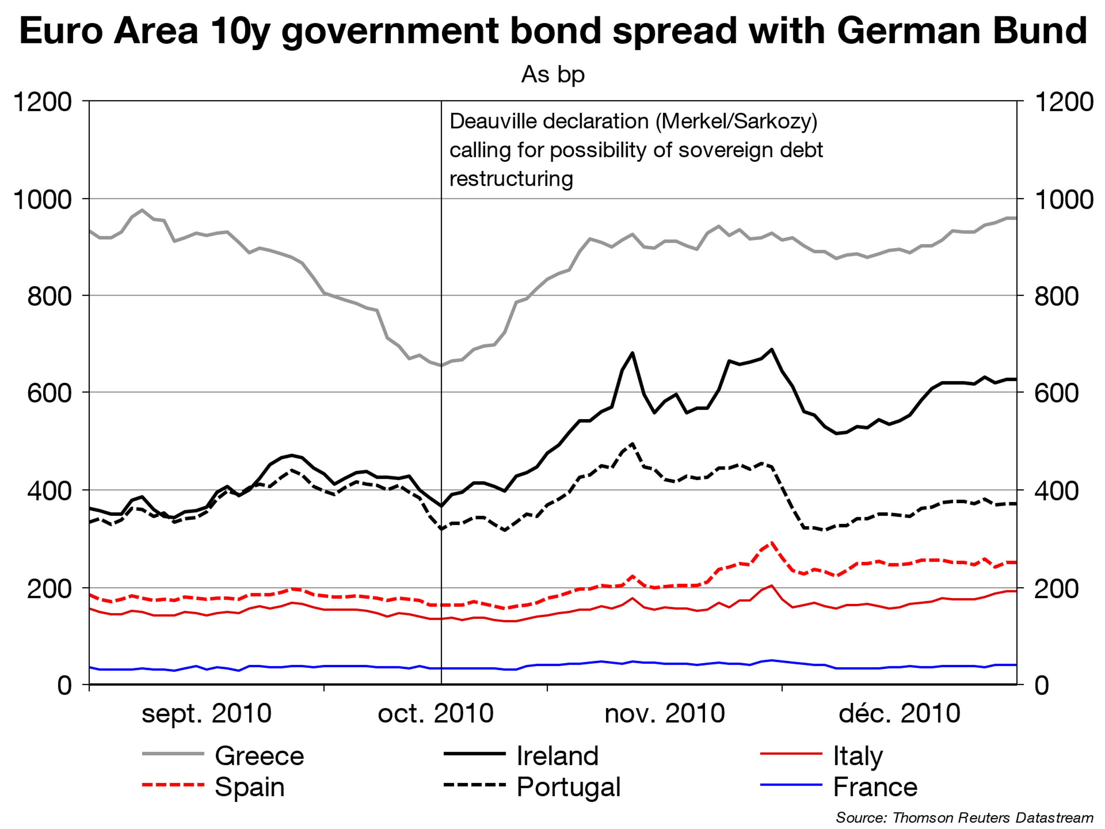
RISKS OF MARKET DISCIPLINE
Some proposals could annihilate the Draghi put.
Proposals for automatic restructuring of sovereign debt in case of ESM bail-out have been floated in the past, with devastating consequences
P.24
Notes:
Deauville declaration (oct. 2010) by Sarkozy and Merkel: proof that enabling sovereign debt restructuring in a framework like the current Euro Area without real national capacity to adjust (apart from long and painful internal adjustment) leads to redenomination risk.

Slide 26
CONCLUSION: FULL FINANCIAL INTEGRATION
Risk reduction
Market discipline
Risk sharing
Full financial integration
Pan-EA banks Eurobonds
Fiscal capacity
P.25
Notes:
To conclude, we need to tackle the 3 aspects at the same time.
A general outlay of our view here is that we could summarize the proposals as a full financial integration based on:
- NPL reduction…
… through a true European supervision…
… accompanied with cross-border mergers to create true Euro Area wide banks…
…With true Eurobonds including joint and several liability on the “blue” part.
… and a fiscal capacity to reduce the impact of asymmetric shocks

Slide 27
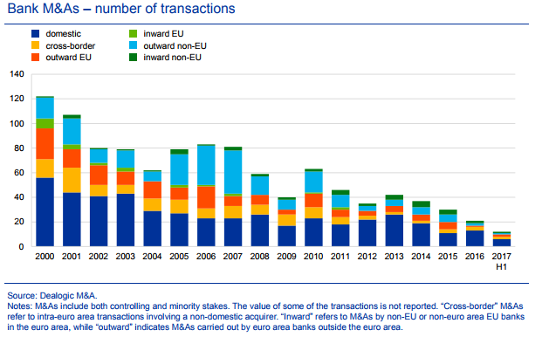
THE EURO AREA IS NOT ON THE ROAD TO PAN-EA BANKS
P.26
Notes:
Statu quo is unsustainable. And the solution for strengthening the EA needs to be more ambitious than just changing sovereign risk weights or reshuffling the stock of existing national debt in other instruments. Pan EA banks and true Eurobonds would give at the same time risk reduction, risk sharing and market discipline for both public debt and banks.
risk reduction pan-EA banks would be more able to reduce NPLs and scrutinized regionally on this front.
risk sharing: Fiscal capacities and true Eurobonds to share part of sovereign risk. Pan-EA banks would help to diversify risks across EZ.
Market discipline: on the stock of national debt not subject to Eurobonds and on which banks would no longer depend

Slide 28
WHAT COULD BE DONE?
OPTIONS MATRIX
P.27

