Slide 1

Regulatory Reform at the Crossroads:
From Implementation to Impact Assessment
Professor Dr. Claudia M. Buch
Deutsche Bundesbank
International Centre for Monetary and Banking Studies (ICMB)
Geneva, October 4, 2016
1

Slide 2
Post-crisis financial regulatory reform
After the crisis, comprehensive reforms have been launched to enhance the stability of the financial system and to ensure its contribution to economic growth.
Make financial institutions more resilient
End too-big-to-fail and enable the resolvability of large financial institutions
Make OTC derivatives markets safer
Improve the supervision of shadow banking activities
Reforms sometimes entered into unchartered territory.
Assessing the effects of reforms requires a structured process of policy evaluation.
Rigorous testing of reforms ex ante has not always been feasible.
Evaluation ex post and causal impact assessment becomes even more important.

Slide 3
This presentation
Key trends in bank capital and profitability
Bank profitability and financial stability
Towards a framework for the evaluation of regulatory policies

Slide 4
I. Key trends bank capital and profitability

Slide 5
The capitalization of European banks has increased, but the decline in overall leverage has been more modest.

Slide 6
Deleveraging of European banks has been stronger for risk-weighted than for total assets.

Slide 7
Overall debt levels in the non-financial sector remain elevated.

Slide 8
The return on equity of banks has declined …

Slide 9
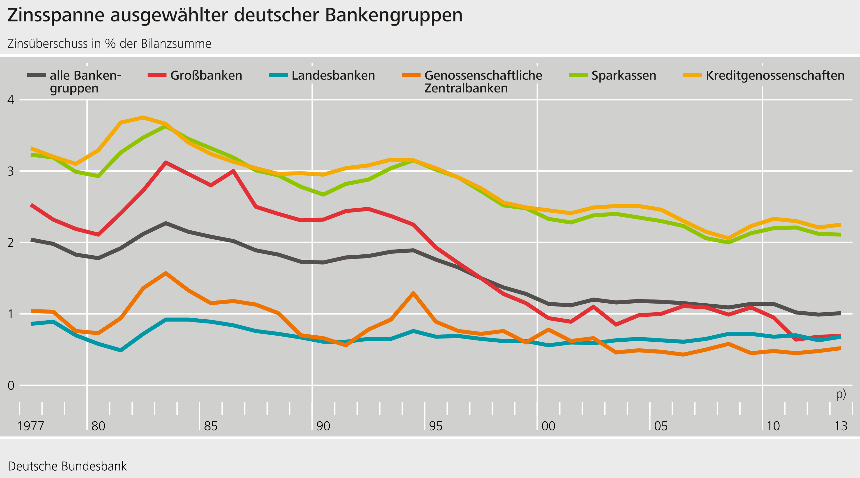
… following a longer-term trend for German banks.

Slide 10
The level of bank capital affects banks’ capacity to lend.
Assuming a static balance sheets, higher capital requirements may – in the short-run – induce a reduction in bank lending.
But, in the medium- to long-term, better capitalized banks lend more.
Better capitalized banks have lower funding costs.
Better capitalized banks lend more, and their lending is more stable over the cycle (Gambarcorta and Shin 2016).
Regulatory constraints are less binding for better capitalized banks (Buch and Goldberg 2016).
Optimal dividend policies differ from a private and public point of view.
Share prices of many European banks are below book values.
Paying out dividends may be in the interest of shareholders and bank managers.
Between 2007 and 2014, accumulated dividends of a sample of 90 European banks were 63% of retained earnings (Shin 2016).

Slide 11
II. Bank profitability and financial stability

Slide 12
Financial stability and systemic risk
The financial crisis has shown that risks which affect individual banks (or market segments) can have systemic implications.
Compared to global financial assets, the US subprime market has not very big.
Yet, the crisis triggered a decline in global GDP by -3.2% (2009).
Governments intervened massively to support distressed banks; public debt has increased significantly.
Systemic risks arise if the distress of one institution or a group of financial institutions threatens the stability of the entire financial system – with negative effects for the whole economy (Hellwig 1998).
Direct contagion through financial linkages
Indirect contagion through asymmetries of information, panics, fire sales of assets

Slide 13
Financial crises have high costs in terms of lost output.
Deviation of output growth from pre-crisis trends.
Source: Laeven and Valencia (2013)

Slide 14
Financial crises arising from credit bubbles have particularly high real and social costs.

Slide 15
The increase in public debt after the financial crisis has been substantial.

Slide 16
Macroprudential policy aims at reducing systemic risks by …
… mitigating distortions in investment decisions
… increasing risk buffers and the capitalization of the financial system
… reducing excessive risk taking
… internalizing systemic risk externalities
A higher degree of capital in the banking sector increase both, the stability of the individual bank and the resilience of the entire financial system.

Slide 17
Are changes in bank profitability a good indicator for risks to financial stability?
(Declining) bank profitability is often interpreted as an indicator for the unintended effects of regulatory reforms.
Yet, changes in bank profitability can have different causes:
Regulatory reforms: Higher equity capital and a reduction of TBTF subsidies tend to reduce profitability
Monetary policy: Short- and long-term effects on bank profitability differ.
Structural changes in the real economy and in the financial system affect bank profitability. A high degree of competition and high cost-to-income ratios suppress bank profitability.
The link between bank profitability and (systemic) risk is not clear-cut.

Slide 18
Are changes in bank profitability a good indicator for risks to financial stability?
In the current environment of low interest rates, standard proxies for (systemic) risks in the banking sector are distorted:
Low borrowing costs overstate the sustainability of debt levels.
Insolvencies in the corporate sectors are low.
Macroeconomic and interest rate risks are shifted to the balance sheets of leveraged financial institutions.
Risks to financial stability can arise from …
… common exposures to macroeconomic risks (too many to fail)
… linkages (too connected to fail)
… the amplification of idiosyncratic risks (too big to fail).
From a macroprudential perspective, sufficient capital buffers are crucial to mitigate systemic risks.

Slide 19
III. Towards a framework for the evaluation of regulatory policies

Slide 20
Towards a framework for the evaluation of regulatory policies
Macroprudential policy is a new field, and most macroprudential instruments are largely untested.
What are appropriate objectives and (intermediate) policy targets?
What level of granularity is needed for the surveillance of financial stability?
Which theoretical models guide policymaking?
How to measure the effects of reforms?
This uncertainty entails risks …
… of an inaction bias and the quest for “more data” and “more analysis”.
… of (ab)using macroprudential policies for other policy purposes.
A clear strategy for (ex-post) policy evaluation is needed.

Slide 21
A stylized evaluation process
Step 1: Specify the objective of reforms
Micro- versus macroprudential
Interaction with other policy goals
Step 2: Define intermediate targets
Objectives of reforms can be analyzed only over time.
Intermediate variables are needed to monitor effects of reforms.
Step 3: Calibration of reform elements, ex ante impact assessment
Step 4: Ex post impact assessment
Did instruments achieve the objectives of reforms?
Which intermediate objectives are useful?

Slide 22
Summing up
Resilience of the financial sector needs to be assessed in terms of lower (systemic) risk and higher capital.
Consistent and credible application of the new rules is crucial.
Risks to financial stability build up gradually in an environment of low interest rates.
Evaluation of regulatory reforms requires a structured process.
Consider short- and the long-term effects of reforms.
Consider partial- and general equilibrium effects.
Structural reforms are needed, both in the real and the financial sector.
Low real returns reflect weaknesses of the real economy.
A high degree of competition in the financial sector can compress margins and encourage risk taking.

Slide 23
Regulatory Reform at the Crossroads:
From Implementation to Impact Assessment
Professor Dr. Claudia M. Buch
Deutsche Bundesbank
International Centre for Monetary and Banking Studies (ICMB)
Geneva, October 4, 2016
23

