Slide 1
Italy’s adjustment Fiscal Structural Banking Policies
Pier Carlo Padoan, MP Rome

Slide 2
OUTLINE
PUBLIC FINANCE AND GROWTH
BANKS
REFORMS
SCENARIOS

Slide 3
PUBLIC FINANCE AND GROWTH
THE NARROW PATH

Slide 4
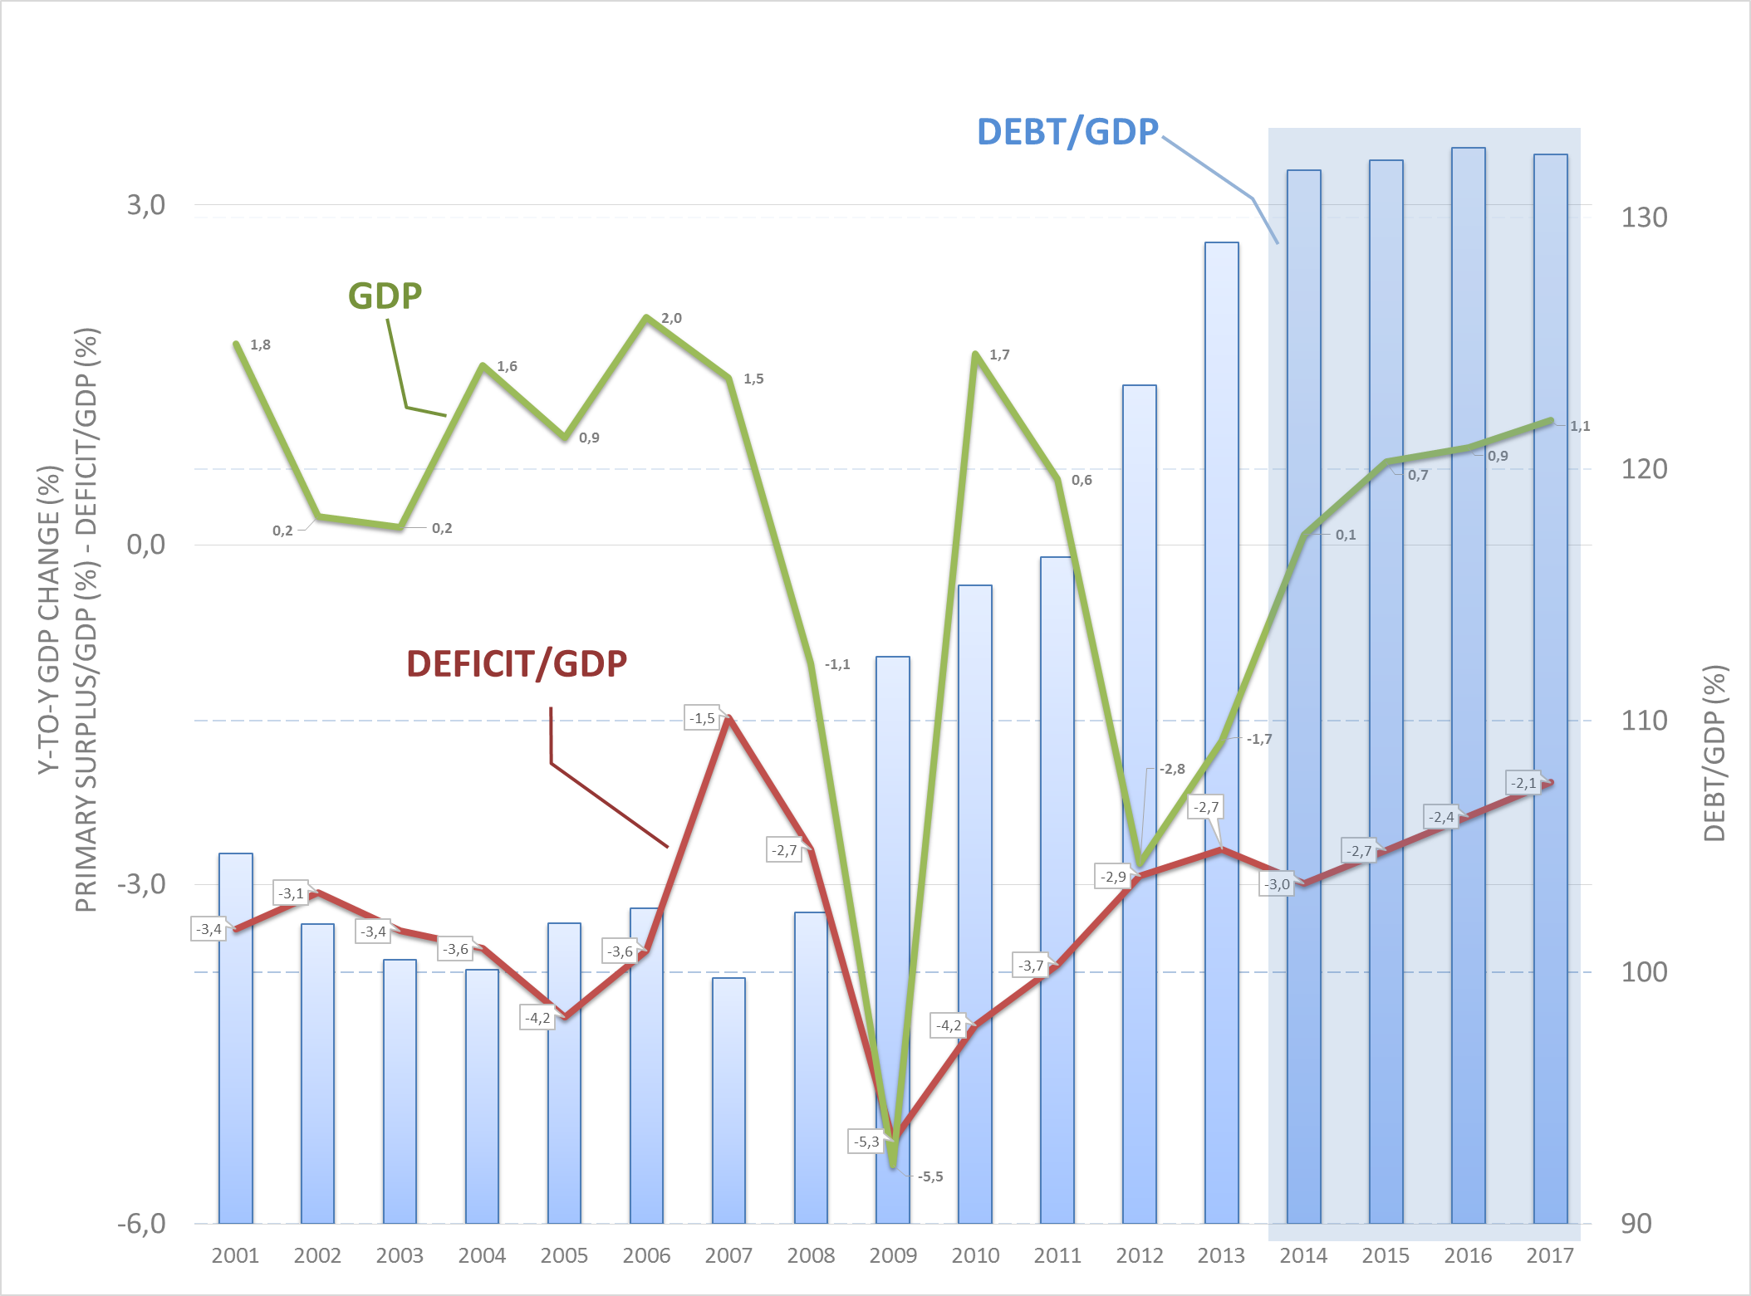
THE NARROW PATH

Slide 5
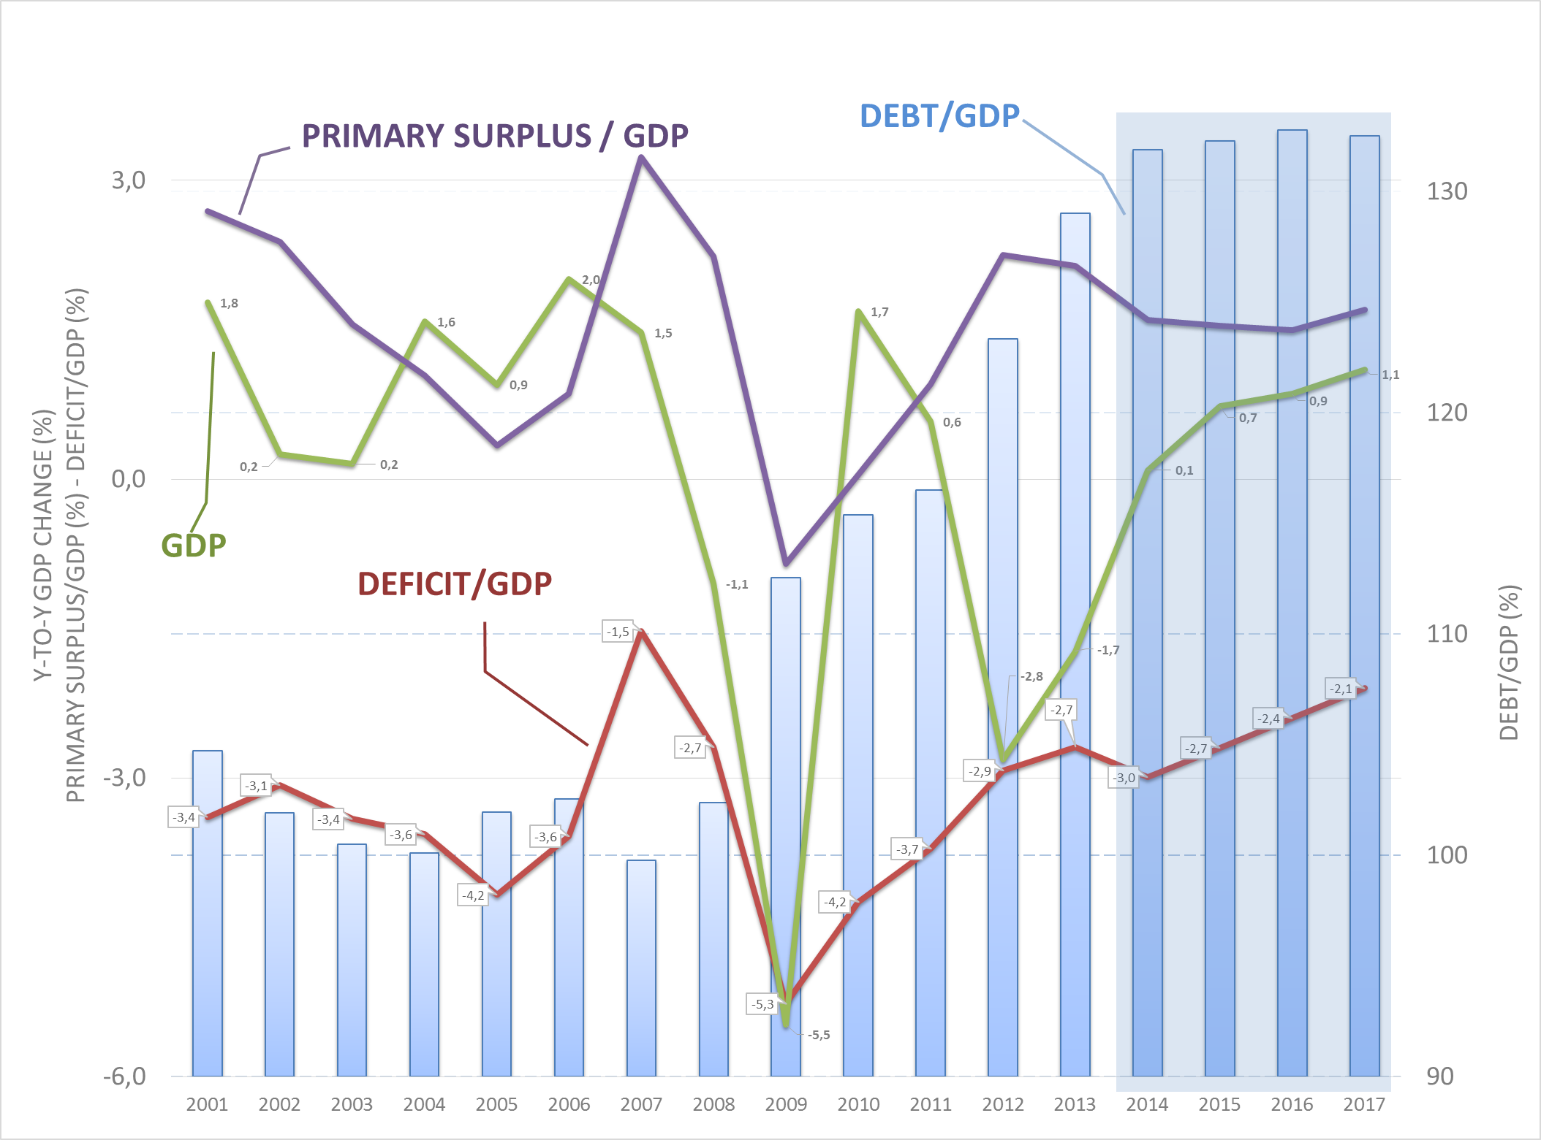
THE NARROW PATH

Slide 6
PRIMARY BALANCE: ITALY vs GERMANY 1995-2016 (% of GDP)
ITALY
GERMANY
Number of years in which the balance was negative:
Italy: 1
Germany: 9

Slide 7
Growth and Primary Balance
KEY
Primary Balance / GDP
GDP y-o-y change

Slide 8
Real Total Expenditure Excluding Interest: Change 2016/2009 (2010=100)
SPAIN
ITALY
UK
NETHERLANDS
US
EU
JAPAN
FRANCE
GERMANY
Source: Ameco database
Real total expenditure excluding interest of general government, deflator GDP :- ESA 2010 (OUTGI)

Slide 9
Real Total Expenditure Excluding Interest: Change 2016/2013 (2010=100)
Source: Ameco database
Real total expenditure excluding interest of general government, deflator GDP :- ESA 2010 (OUTGI)

Slide 10
Debt\gdp growth and components (source Ambrosetti)
 | Debt\gdp | interest | inflation | Growth | Primary surplus
80-94 | +63.2 | +147.3 | -85.7 | -22.5 | +24.2
95-07 | -17.4 | +82.9 | -36.5 | -23.0 | -40.8
08-12 | +23.6 | +33.4 | -12.8 | +7.4 | -4.6
13-17 | +8.8 | +21.8 | -2.5 | -2.5 | -8.0

Slide 11
BANKS
CRISIS MANAGEMENT IN A NEW REGULATORY ENVIRONMENT (BANKING UNION)
RECOVERY FROM THE LEGACY OF THE CRISIS

Slide 12
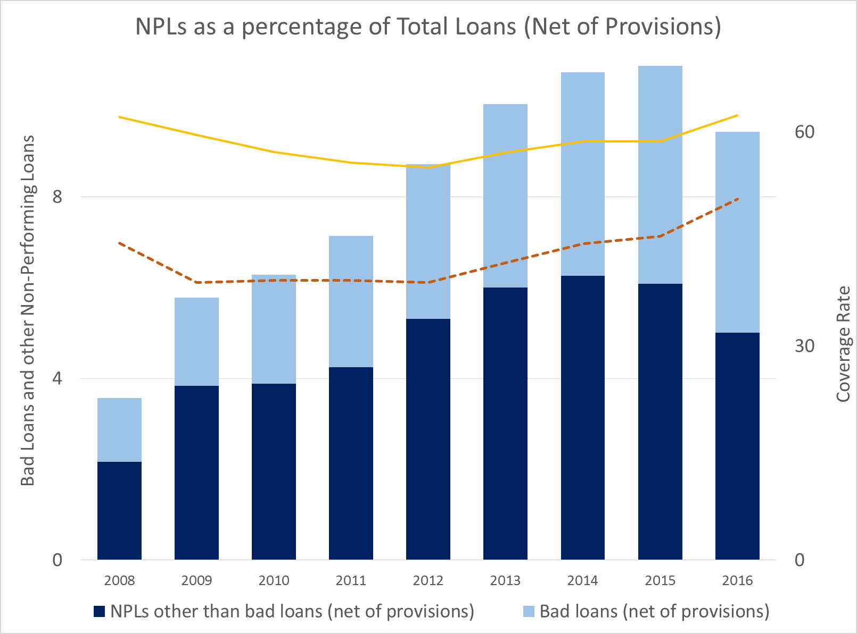
NPLs as a Percentage of Total Loans (Net of Provisions)
Coverage Rate of Bad Loans
Coverage Rate of Total NPLs

Slide 13
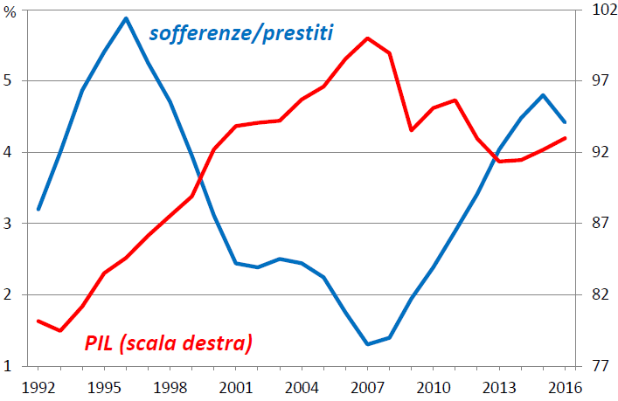
Net Bad Loans as a percentage of Total Loans and GDP growth
GDP (right scale)
Net Bad Loans / Total Loans

Slide 15
Cross border risk sharing

Slide 16
Risk reduction. Euro area banks fragility decreasing
Bank profitability
Capital adequacy ratio

Slide 17
STRUCTURAL REFORMS
RECOVER/BOOST
POTENTIAL
GROWTH

Slide 18
The impact of the crisis on EU drivers of growth

Slide 19
Reform agenda 2012-17
Pension reform (Fornero, completed, now under attack)
Labor market (Jobs Act almost completed, now under attack))
Public administration (half completed)
School system (Buona Scuola half completed)
Civil Justice (almost completed)
Banking sector (Popolari, Small cooperative. Completed, under attack)
Tax administration (almost completed)
Institutional reform (rejected via referendum)
Competition code (partially completed)

Slide 20
Reform agenda 2012-17 cont.
Supporting investment, innovation and productivity
Tax benefits
Industry 4.0
Finance and growth

Slide 21
The reform drivers
1) The structural reforms cycle. Time to introduce, implement, deliver benefits
2) SR impact growth through investment. Investment needed to incorporate innovation and/or more investment because of reforms raising profitability
3) The macro/structural interaction. A trade off between flexibility and macro (budget) integration (De Grauwe)? A virtuous interaction rather than a trade off.
4) The fading support for EU

Slide 22
Reforms drivers 1) the reform cycle
The structural reforms cycle.
Time to introduce, implement, deliver benefits can take several years. (eg. longest lag in human capital accumulation)
Political costs may be very high if the reform cycle is too long
Incentives to introduce reforms decline over time
Budget space for supporting/compensatory measures may be limited
The macro environment also matters for the diffusion of benefits

Slide 23
GDP GROWTH VS. EMPLOYMENT RATE
Employment rate
GDP change

Slide 24
Structural reforms. Civil Justice
Some initial results

Slide 25
DAYS

Slide 26
Reforms responsiveness rate declining (OECD)

Slide 27
Reforms drivers 2) investment
SR impact growth through investment
Investment needed to incorporate innovation
More investment because of reforms raising profitability
Barriers to investment are relevant (EIB Survey). Many require SR action.
More relevant: lack of skilled personnel, uncertainty about the future (politics?), regulation
Less relevant: finance, physical infrastructure, digital infrastructure
Case for bundles of reforms

Slide 28
Public investment has declined

Slide 29
Private investment picking up

Slide 30
Public investment matters (OECD)

Slide 31
Reform drivers 3) Macro structural interaction
A trade off between flexibility and macro (budget) integration? (De Grauwe) For more flexibility more national level policy. For more macro support more eu level policy
A virtuous interaction rather than a trade off.
More macro support makes structural reforms more effective (through investment). More SR make investment more attractive
But…reform fatigue is affecting the macro agenda too

Slide 32
Fiscal stance in the euro area (PRACTICALLY NEUTRAL?)

Slide 33
EU current account polarisation?

Slide 34
Reform drivers 4) political support
Support for reforms (almost) equivalent to support for EU?
The crisis has impacted on EU support in a framework of increasing disparities
Support for Euro membership is diversified
Inequality has increased within countries
Welfare provision across countries is also diversified

Slide 35
Citizens support for EU (percentage of individuals supporting)

Slide 36
Support for Euro membership (a growing divide?)

Slide 37
Inequality indexes OECD. Declining between increasing within countries

Slide 38
Disparity in well being outcomes. Euro area, highest and lowest achievers

Slide 39
Welfare disparities in EU

Slide 40
Scenarios (1) the narrow path gets larger
Public finance consolidation continues
Growth rises and becomes structurally higher (investment and SR continue/accelerate)
Banking sector repair and consolidation continues. Facilitates investment spending
Confidence in the future increases
Risk assessement improves. Benefits banks , budget, cost of funding
Benefits of structral reforms are felt more strongly. Confidence building proceeds
Europe sends positive signals

Slide 41
Scenarios (2) instability prevails
Deficit and debt increase. Dynamics increasingly out of control
Possible restriction measures
Growth and investment decelerate
Reform effort wanes (never takes off)
Inequality perceived as increasing
Risk assessment deteriorates, hurting the budget, banks, cost of funding
Confidence precipitates
Europe’s fragmentation increases
…………..???

