Slide 1


Is the Euro Crisis Over?
Klaus Regling, Managing Director, ESM
International Center for Monetary and
Banking Studies, Geneva
25 March 2014

Slide 2
Eight reasons for the sovereign debt crisis
  1. Member States did not fully accept the political constraints of being in EMU
2. Transition to permanent lower interest rates
  3. Economic surveillance too narrow
  4. Methodological problems with calculating structural fiscal balances
  5. Insufficient control of data by Eurostat
  6. Financial market supervision too lax and mainly national
  7. Institutional gaps, no crisis resolution mechanism
  8. Biggest financial crisis in 80 years

Slide 3
A comprehensive response to the euro crisis
    Significant fiscal consolidation and structural reforms at national level
    Macroeconomic imbalances are disappearing
    Improved economic policy coordination in the euro area
    More comprehensive and stricter rules for policy coordination
    Institutional innovations: financial backstops and OMT
    EFSF and ESM have disbursed €222 bn to Ireland, Portugal, Greece, Spain and Cyprus
    Potential concerted ESM – ECB intervention possible
    Reinforcing the banking system
    European banks have Core Tier 1 capital ratio of 9% or more
    Moving towards Banking Union

Slide 4

EFSF/ESM programme countries are the reform champions
Greece, Ireland, Portugal and Spain are in top 5 of 34 OECD countries with regard to implementation of structural reforms
Ranking in OECD report
1. Greece
2. Ireland
3. Estonia
4. Portugal
5. Spain
“Euro area countries under financial assistance programmes are among the OECD countries whose responsiveness [to the OECD’s structural reform recommendations] was highest and also where it most increased compared with previous period.”
- Going for Growth 2013 (OECD Report)
Source: OECD report Going for Growth 2013
Ranking takes into account responsiveness to OECD recommendations on structural reforms in key policy areas
3

Slide 5
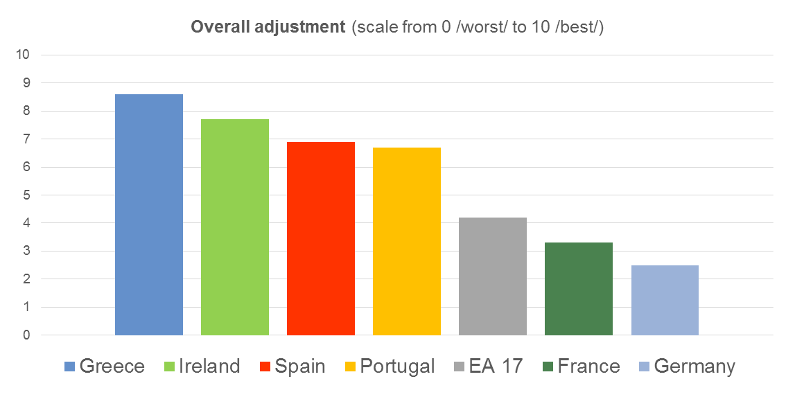
EFSF/ESM programme countries are the reform champions (2)
Lisbon Council: Greece, Ireland, Spain and Portugal ranked highest in overall measure of 4 key medium-term adjustment criteria:
    Rise in exports
    Reduction of fiscal deficit
    Changes in unit labour costs
    Progress in structural reforms
1.
2.
3.
4.
14.
16.
Source: “Adjustment Progress Indicator” in 2013 Euro Plus Monitor published by the Lisbon Council
The ranking comprised 17 euro area countries + UK, Poland and Sweden
4

Slide 6
The strategy is delivering results - competitiveness
Divergences within EMU are declining
Competitiveness is improving in all Member countries that have borrowed from EFSF/ESM
Nominal unit labour costs, whole economy (2008=100)
Current Account Balance (as % of GDP)
Germany
Ireland
Greece
Source: Eurostat,
EC European Economic Forecast - Winter 2014
Portugal
Spain

Slide 7

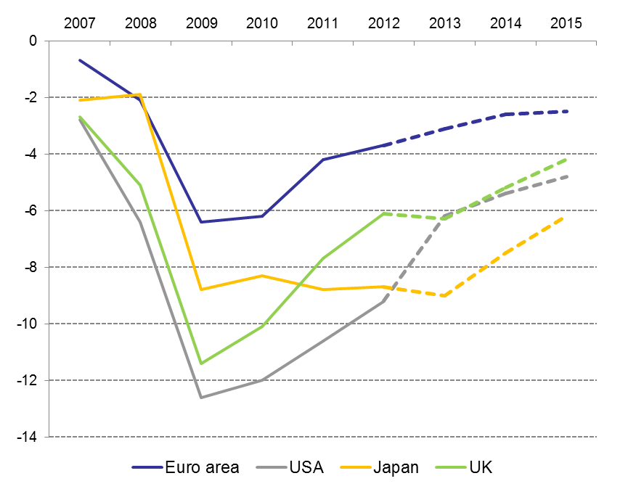
The strategy is delivering results - fiscal
Fiscal balance, euro area Member States (as % of GDP)
Fiscal balance, Euro area vs USA and Japan (as % of GDP)
*
Source: European Commission, European Economic Forecast – Winter 2014
* Actual figure for Ireland in 2010: -30.6%

Slide 8
Risks and issues moving forward
Economic growth
Deflation
Debt sustainability

Slide 9
GDP per capita growth almost identical in the euro area and US
GDP per capita growth, annual % change
Average GDP growth per capita, 1994-2013
euro area | 1.1
US | 1.1

Slide 10
Labour markets in the euro area and US
During the last decade employment and participation rate have increased strongly in the euro area but fallen in the US
Employment rate
Participation rate
Unit: %
Latest observations: Q3 2013 for euro area, Q4 2013 for US
Source: Eurostat and BLS
Unit: %
Latest observations: Q3 2013 for euro area, Q4 2013 for US
Source: Eurostat, BLS and ESM calculations

Slide 11
Creditless recovery?
Declining bank credit does not necessarily constrain economic recovery following a financial crisis, according to research by the BIS
In Europe, the share of bank lending in total financial flows is falling
More mid-size companies obtain funding from the market
Alternative sources of funding are developing: P-2-P, direct lending

Slide 12
Is deflation a real threat?
We are currently experiencing an extended period of low inflation, but not deflation
According to IMF models, the risk of deflation in the euro area is 10-20%
Falling prices and wages in EFSF/ESM programme countries are welcome; this is temporary
Recent data from Eurostat show an acceleration in wage increases (1.9% in Q4 2013)
Economic recovery is gaining pace in Europe

Slide 13
Debt sustainability?
The EFSF and ESM introduced a new framework for providing financial assistance: very low rates at very long maturities
Thus debt service payments are a better indicator of a country’s debt burden than the debt/GDP ratio
Especially evident in the case of Greece:
  Official sector institutions hold 2/3 of Greek government debt
  Greece’s interest payments to EFSF deferred for 10 years; no repayment of capital in the next 25 years
  As a result, Greece saves annually 4.7% of GDP on its debt payments
  Haircut of 14.1% of GDP in NPV terms
  No debt overhang

Slide 14
Debt sustainability: Portugal and Ireland
Portugal
  According to the troika, government debt peaked in 2013 and should decline to 110% by 2020
Ireland
  According to the troika, Government debt peaked at 122% in 2013 and is projected to decline to 102% by 2020
Government debt projections
Source: European Commission

Slide 15
Conclusions: The euro crisis is not over yet . . .
. . . but the end is in sight:
The reasons for the crisis have been addressed
The euro area has moved out of recession
Macroeconomic imbalances within the euro area are shrinking fast
Countries under conditionality are adjusting
Economic policy coordination much broader and stricter
Institutional gaps in the initial design of EMU have been closed
Banks in Europe are becoming stronger

Slide 16
Conclusions: Certain risks to economic recovery are still present
Borrowing countries need to continue their difficult adjustment
Some of them need continued financial support
Financial markets in Europe are fragmented
Potential growth in Europe will be limited
Yet we should keep in mind that . . .
History shows that crises generally trigger positive changes
This is also true in Europe: monetary union will emerge stronger when the crisis is over

