Slide 1
Central bank policy in extraordinary times
Andréa M. Maechler
Member of the Governing Board of the Swiss National Bank
ICMB: International Center for Monetary and Banking Studies
Geneva, 28 March 2017

Slide 2
Challenging macroeconomic and political environment

Slide 3
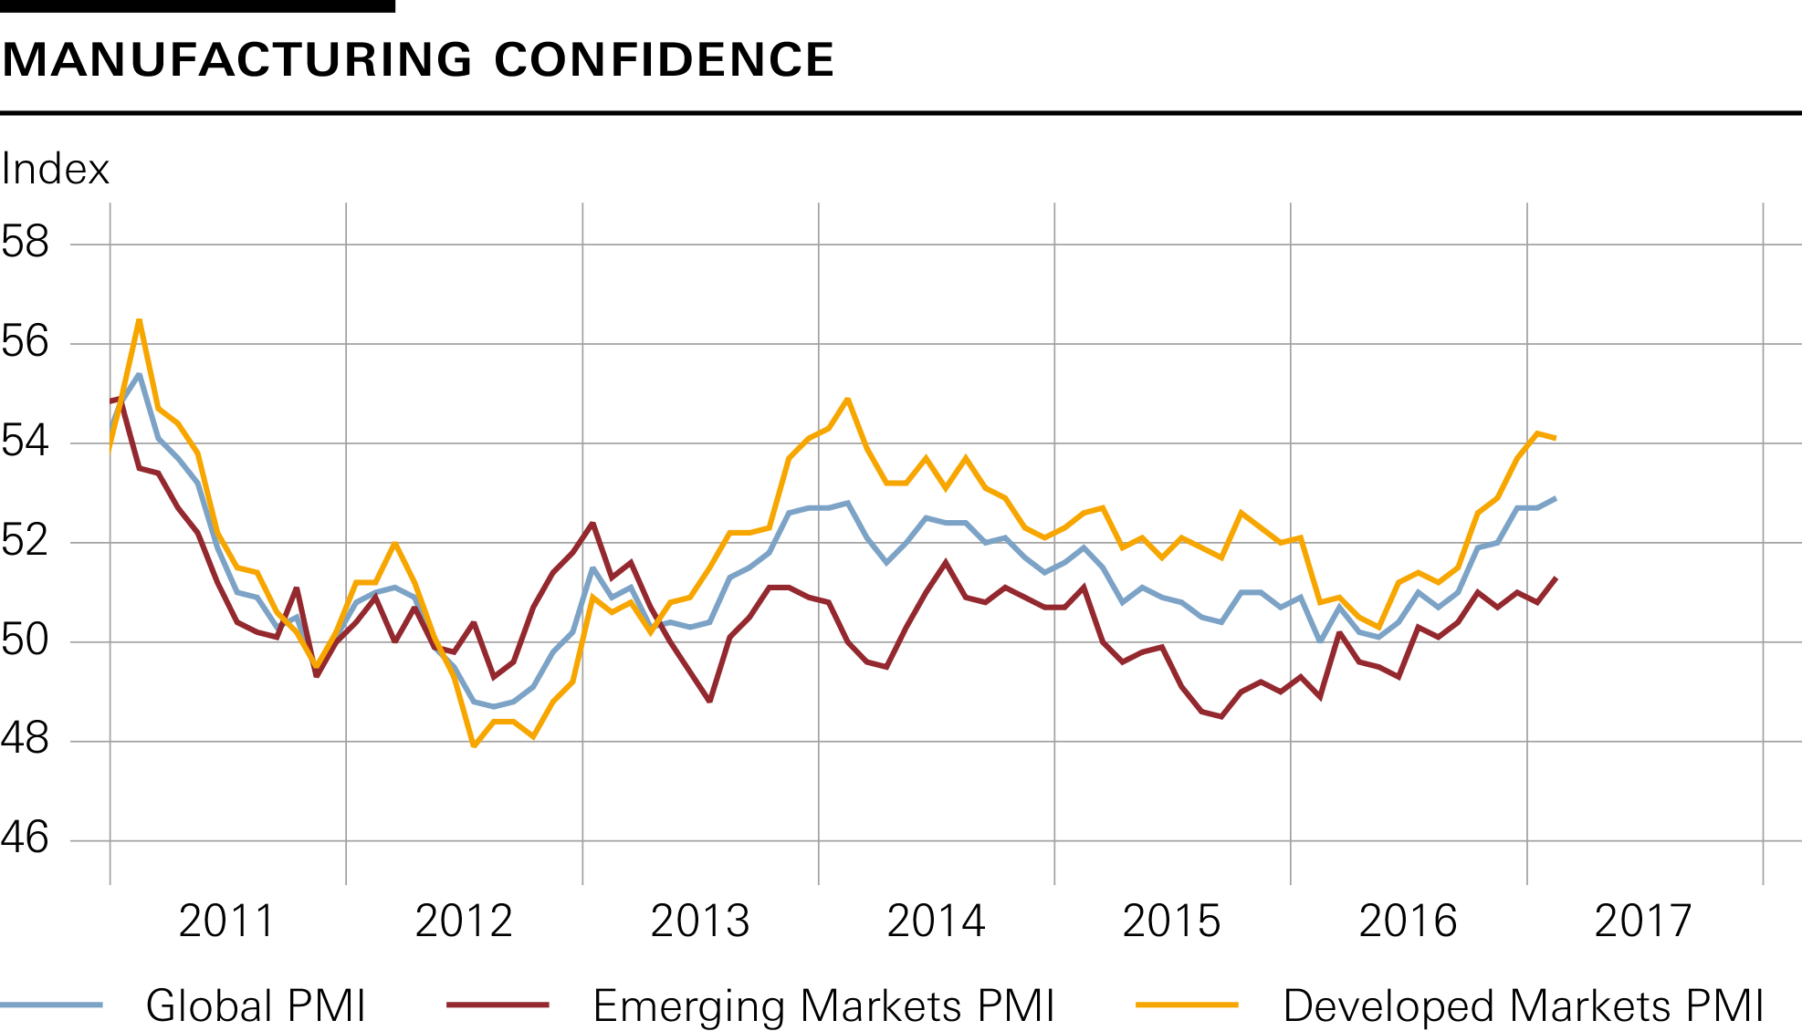
The global recovery is gaining broader momentum
Sources: Datastream, JP Morgan, SNB

Slide 4
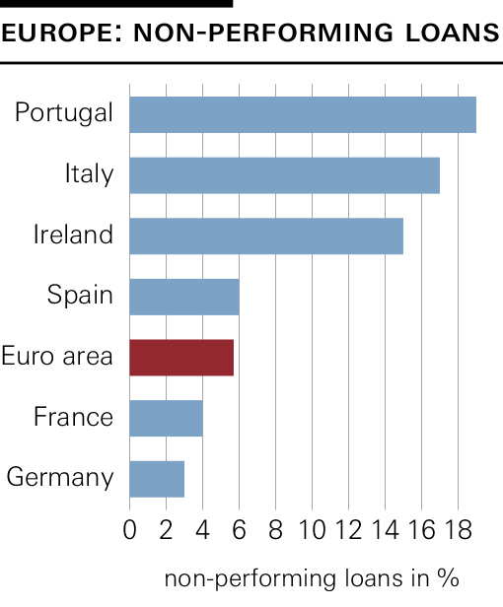
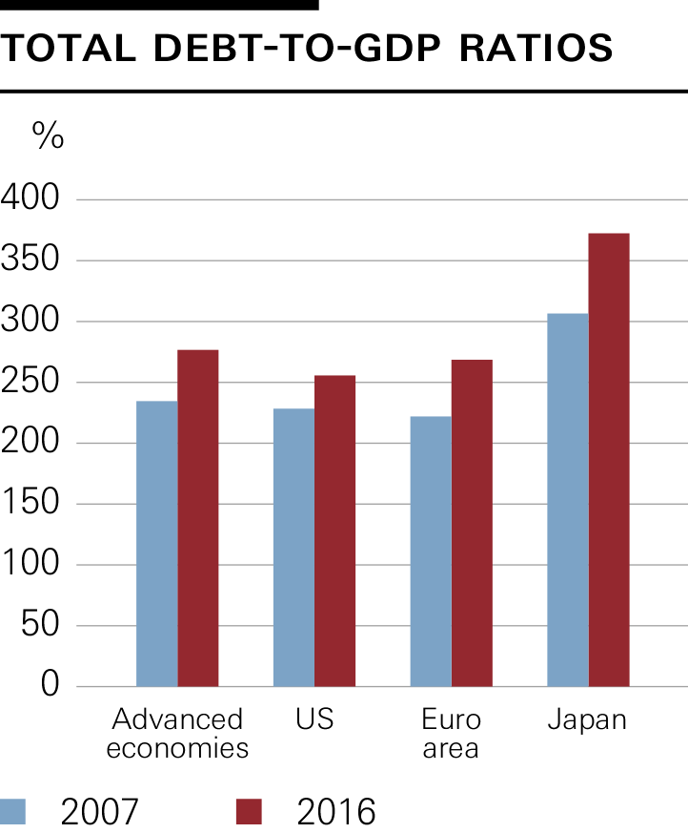
Persistent legacies from the crisis remain: Fragile banking systems and high debt levels
Sources: BIS, EBA, SNB

Slide 5
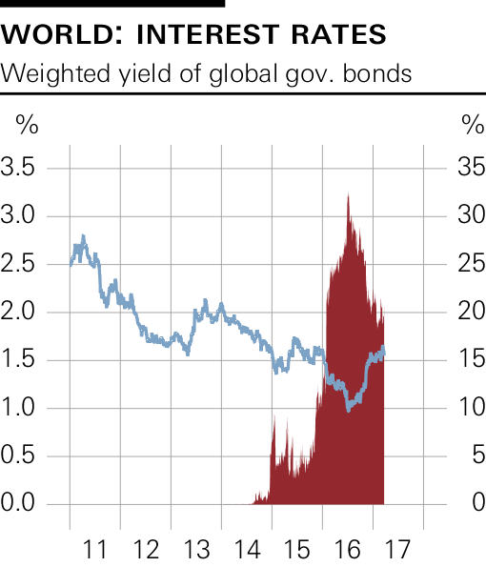
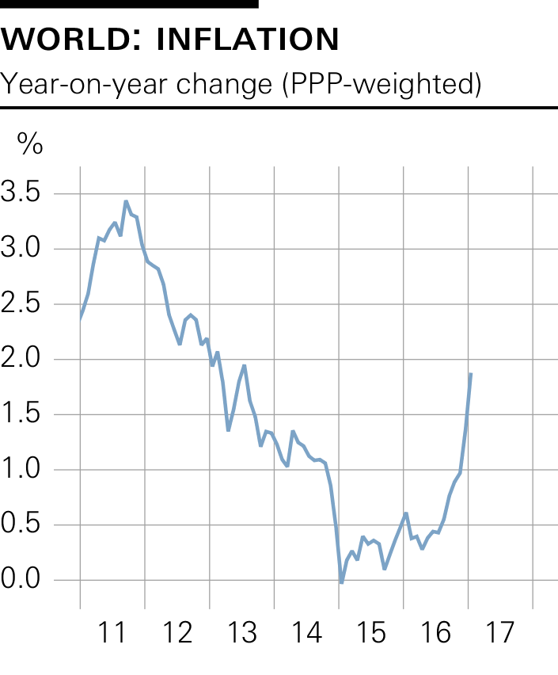
Very low interest rates and rising inflation rates depress real returns for investors and savers
Sources: BAML, Bloomberg, SNB

Slide 6
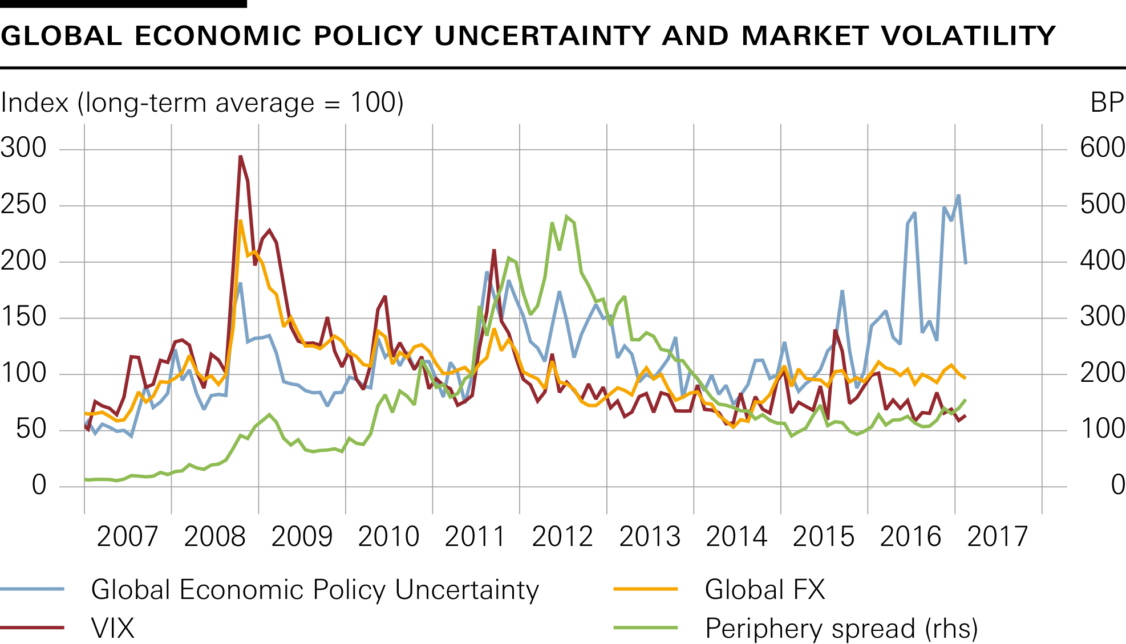
Rising political uncertainty – not reflected in traditional financial risk indicators
Sources: Baker, Bloom & Davis, Bloomberg, SNB

Slide 7
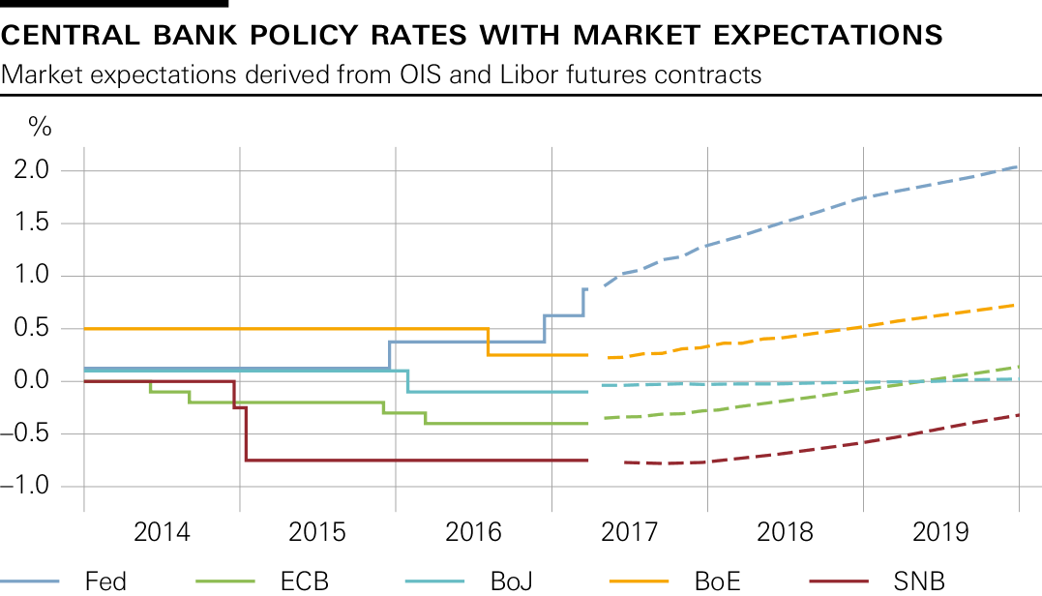
Financial markets continue to expect expansionary monetary policy in most regions
Sources: Bloomberg, SNB

Slide 8
Current monetary policy

Slide 9
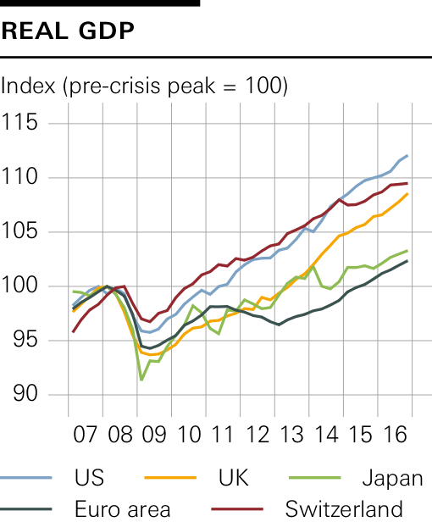
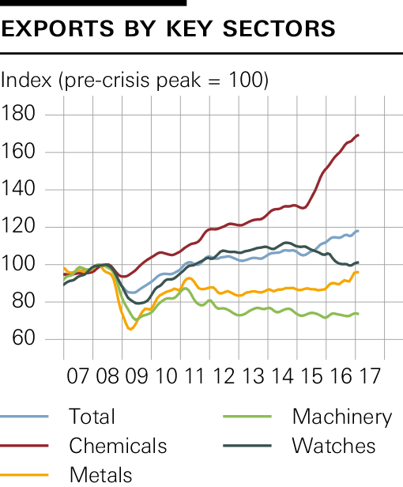
Swiss economy has navigated the challenges relatively well, but recovery is not yet broad-based
Sources: Datastream, SECO, SNB

Slide 10
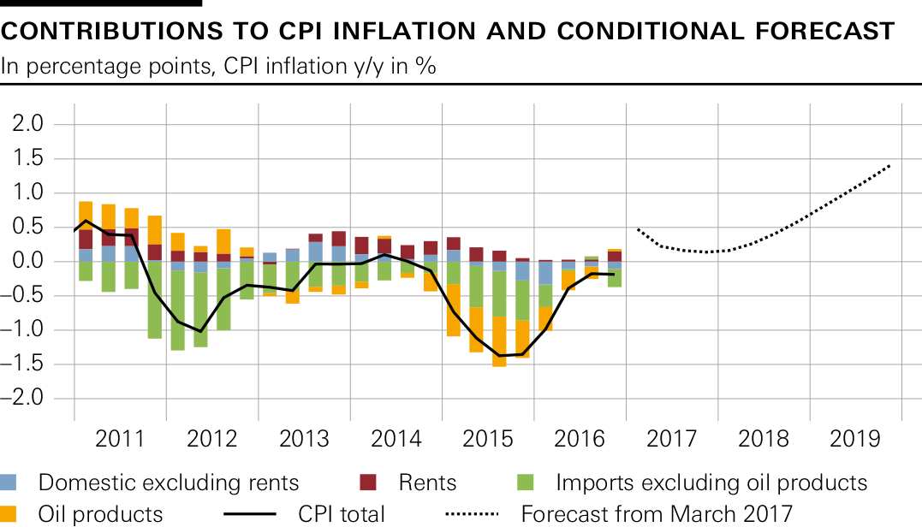
Expansionary monetary policy needed to ensure price stability
Sources: BFS, SNB
–1,1%
–0,4%
+0,3%
+0,4%
+1,1%

Slide 11
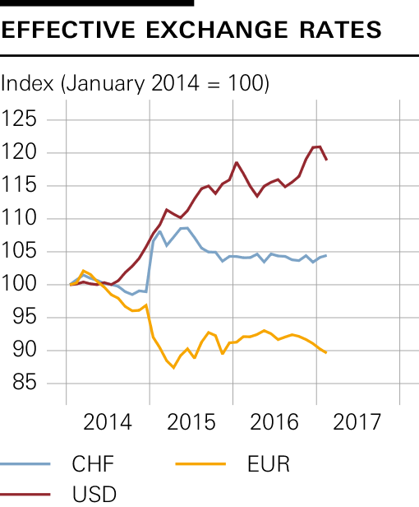
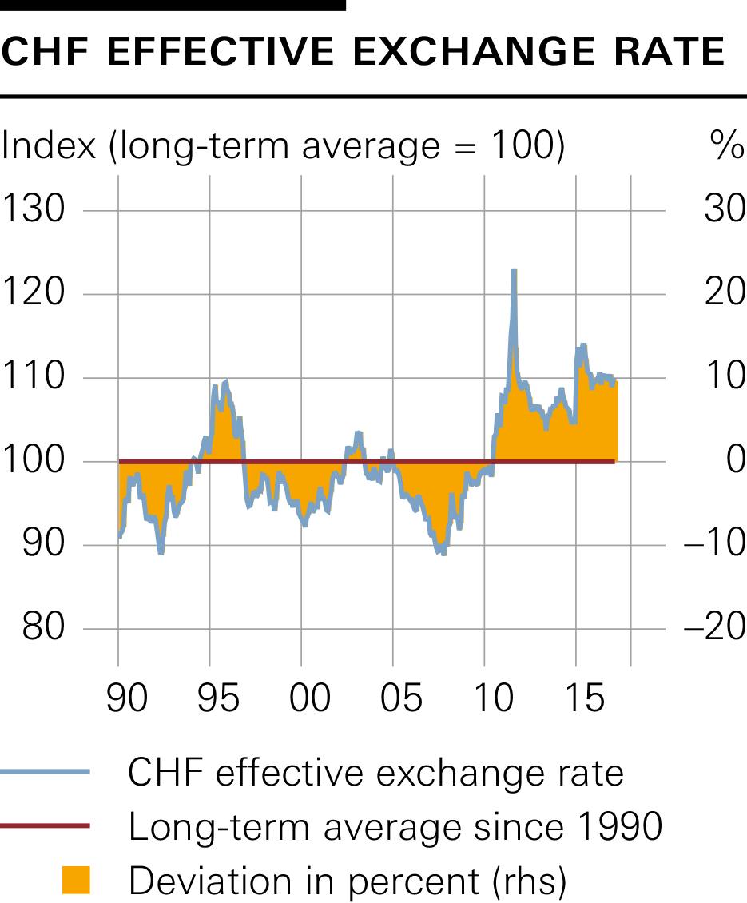
Swiss franc has been relatively stable, but remains significantly overvalued
Sources: Bloomberg, BIS, SNB

Slide 12
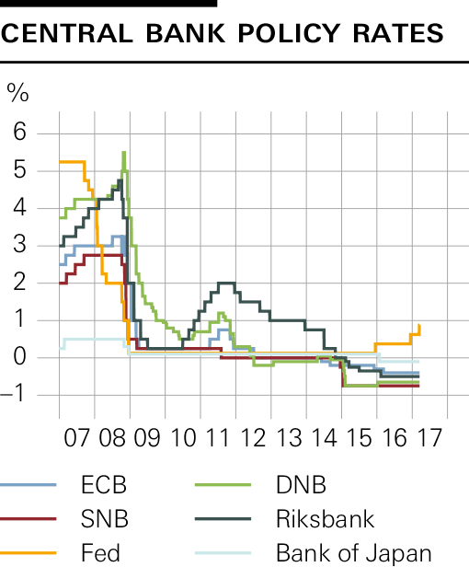
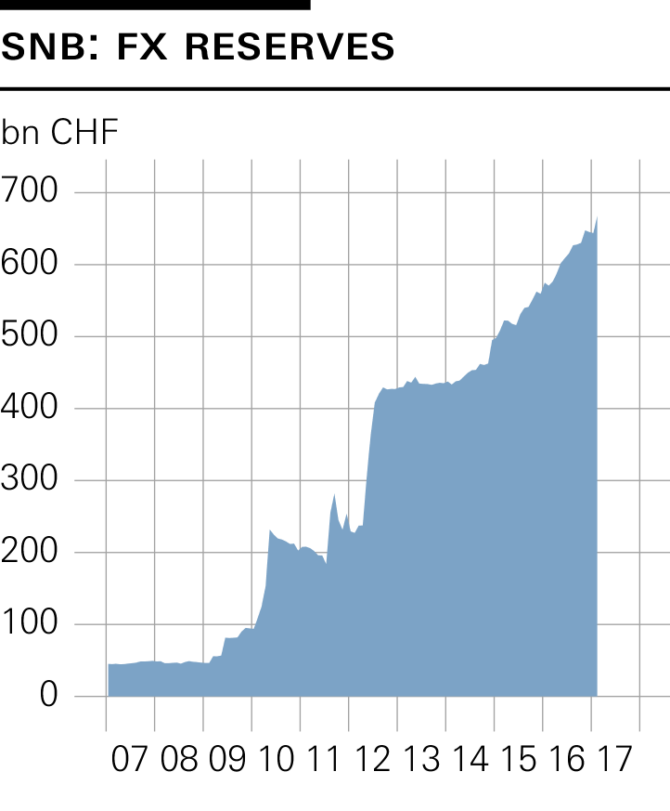
Two instruments to reduce attractiveness of Swiss franc: Negative interest rate and FX interventions as needed
Sources: Bloomberg, SNB

Slide 13
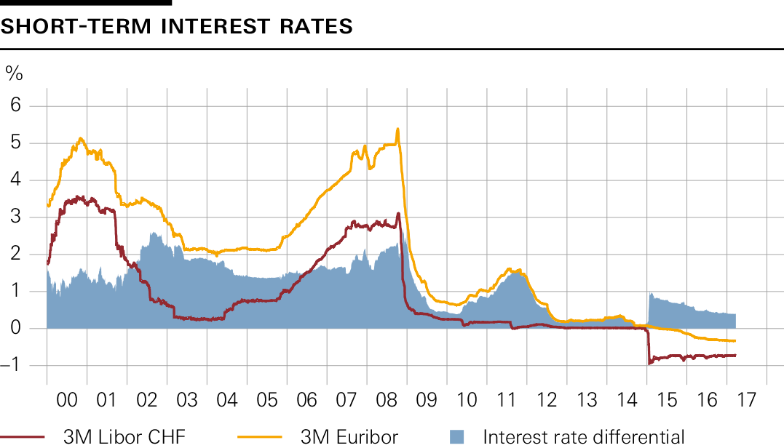
Negative interest rate is necessary to re-establish the interest rate differential against other currencies
Sources: Bloomberg, SNB

Slide 14
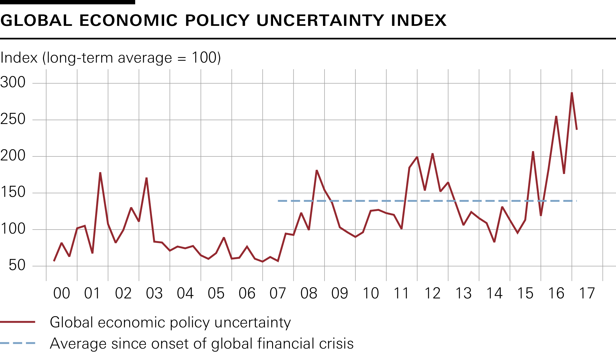
Safe haven properties of Swiss franc remain high against backdrop of political uncertainty
Sources: Baker, Bloom & Davis, Bloomberg, SNB

Slide 15
SNB as a large investor

Slide 16
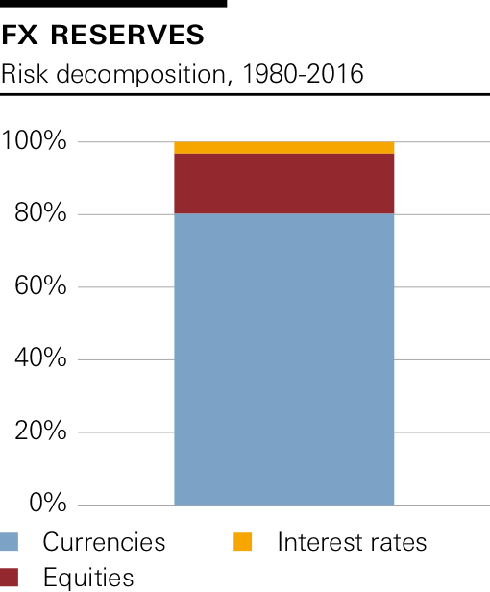
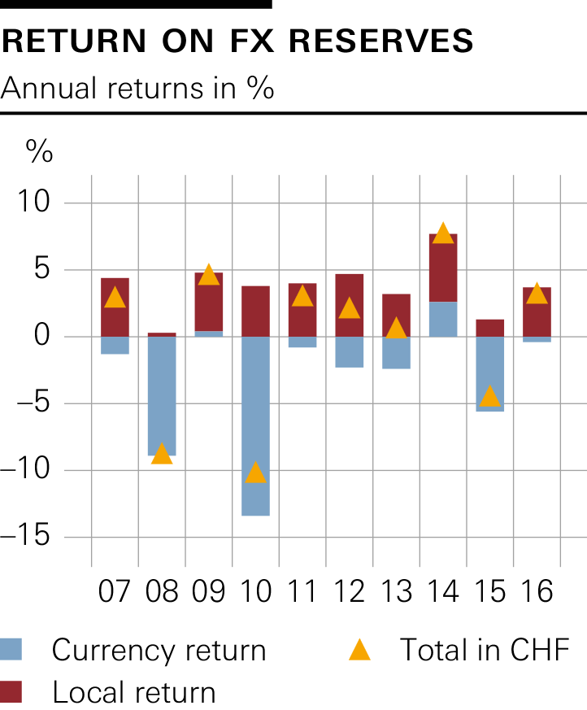
FX risks dominate total risk and drive annual results
Source: SNB

Slide 17
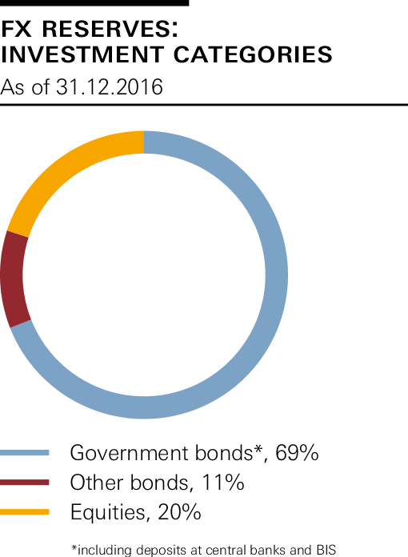
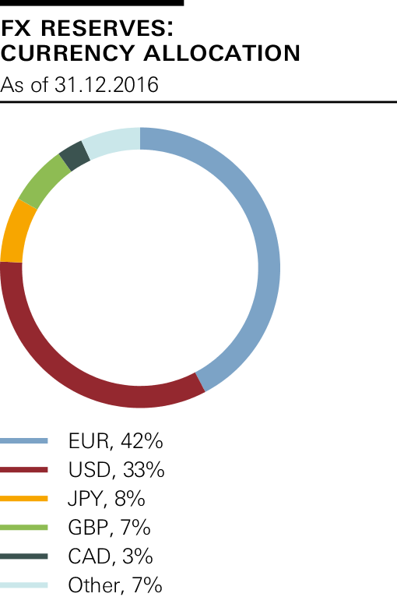
Broad diversification across asset classes and currencies is the SNB's best risk management tool
Source: SNB

Slide 18
Equities expanded to EM, small and mid-caps
2005 – 2012
approx. 1’500 shares
2013
approx. 5’700 shares
Equity portfolio currently covers about 97%
of global equity market capitalisation
2015
approx. 6’700 shares
Source: SNB

Slide 19
Sovereign Wealth Funds - Not a role model for Switzerland
Norway |  |  | Singapore |  |  | SNB
FX investments
Equity based on revenue from oil exports
FX investments
Equity based on fiscal surpluses
FX investments
Sight deposits
Source: SNB.

Slide 20
Sovereign Wealth Fund would have to be fully financed
Norway |  |  | Singapore |  |  | SNB
FX investments
Equity based on revenue from oil exports
FX investments
Equity based on fiscal surpluses
FX investments
Sight deposits
Source: SNB
?

