Slide 1
Beyond Basel: Can Financial Regulation Tackle Tomorrow’s Technology?
Thomas F. Huertas, Partner and Chair, EY Global Regulatory Network
Geneva, 20 March 2018

Slide 2
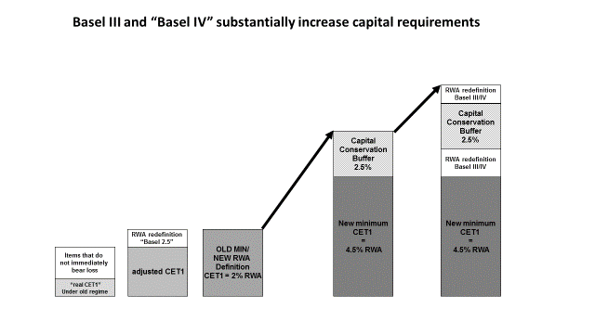
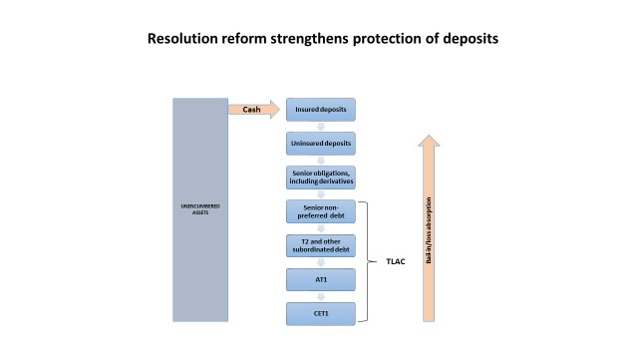
Basel reforms strengthen banks and the financial system as a whole
Higher capital makes banks less likely to fail
Resolution reform makes banks safe to fail
Macro initiatives supplement micro measures
Security and integrity of financial system
Mandatory clearing
Macro-prudential supervision

Slide 3
Technology will disrupt finance
Decline in cost of data storage, data processing, communications
Advances in data management and processing (big data, cloud, blockchain, etc.)
Advances in analytics (machine learning, robotics, artificial intelligence, etc.)
Increased accuracy availability, reliability at reduced cost

Slide 4
Technology poses significant questions/challenges for policymakers
Past
Present
Future
Can banks meet current requirements without using the new technology?
Should the same rules apply to all, incumbents and new entrants alike?
Should the regulator employ the new technology to offer financial services directly to the public?

Slide 5
Current regulations require banks to use the new technology
Area | Example | Question
Customer acquisition | KYC, KYCC | Should each bank be required to do this on its own? Can utilities play a bigger role? “Do it once/do it right” versus “Give it the once over a thousand times”
Supplier due diligence | Review of third-party providers
Transaction banking | AML, sanctions compliance
Capital | Stress testing
Liquidity | Intra-day reporting
Valuation, provisioning | IFRS9
Regulatory reporting | BCBS 239

Slide 6
Should the same rules apply to all?
Area | Example | Question
Payments | PSD2 requires banks to allow third-party providers access (upon consent from customer) to customer information/accounts. | Are regulators creating a regime where new entrants can acquire the relationship and the reward whilst leaving risk and responsibility with incumbents?
P2P lending platforms | Platform provides unaudited information about unlisted financial instruments (loans) without suitability checks to investors who have a bank account.

Slide 7
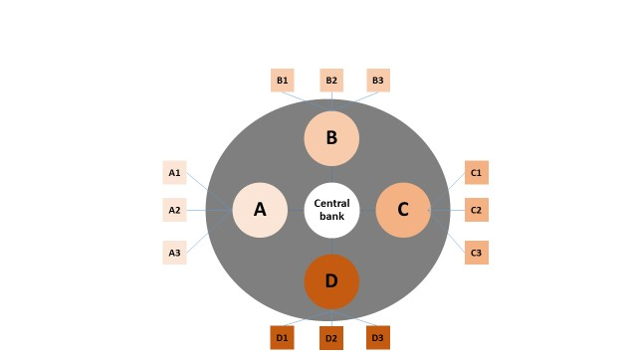
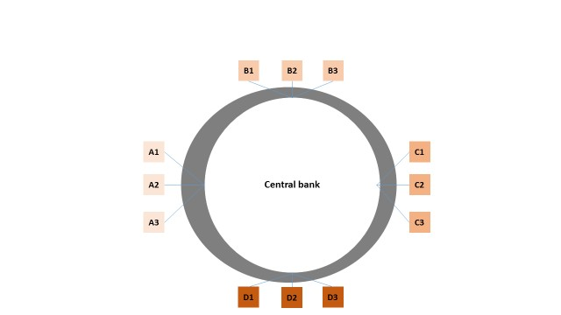
Should central banks be bankers’ banks or people’s banks?
Bankers’ bank | People’s bank
Traditional model failed during the crisis. | Central bank digital currency not only replaces cash but also displaces deposits.

