Slide 1
Germs, War and Central Banks
Pierre Wunsch | Governor, National Bank of Belgium
ICMB Public Lecture

Slide 2
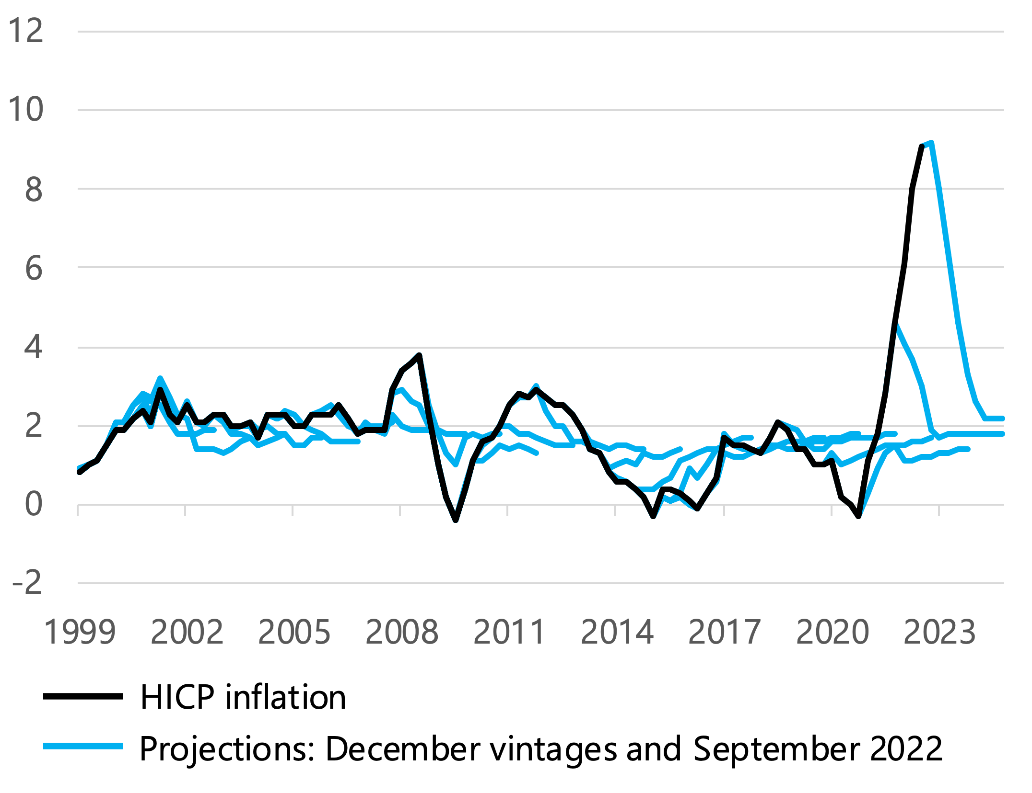
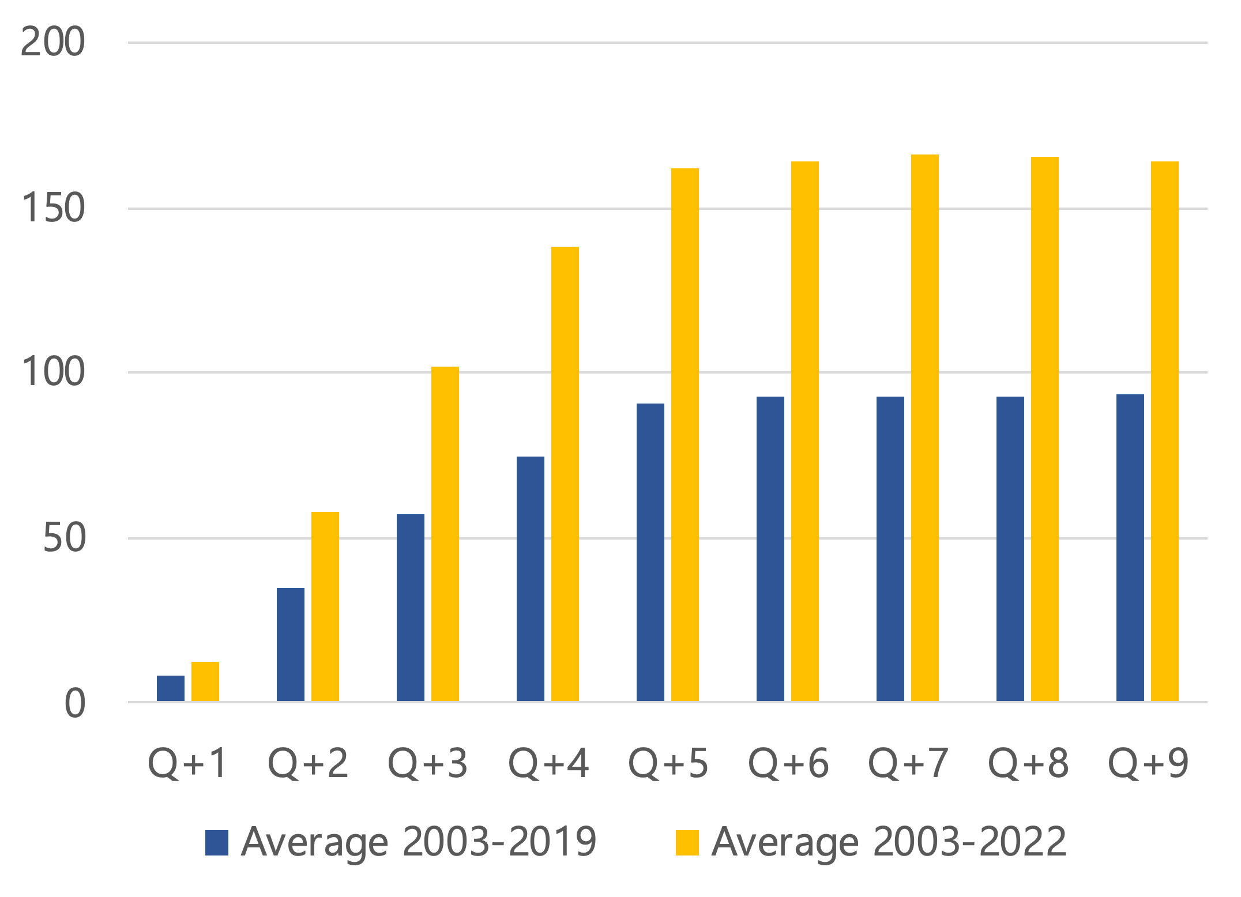
Eurosystem/ECB staff projections: mean reversion and significant errors
Inflation projection vintages
(percentage points)
Projection errors
(basis points)

Slide 3
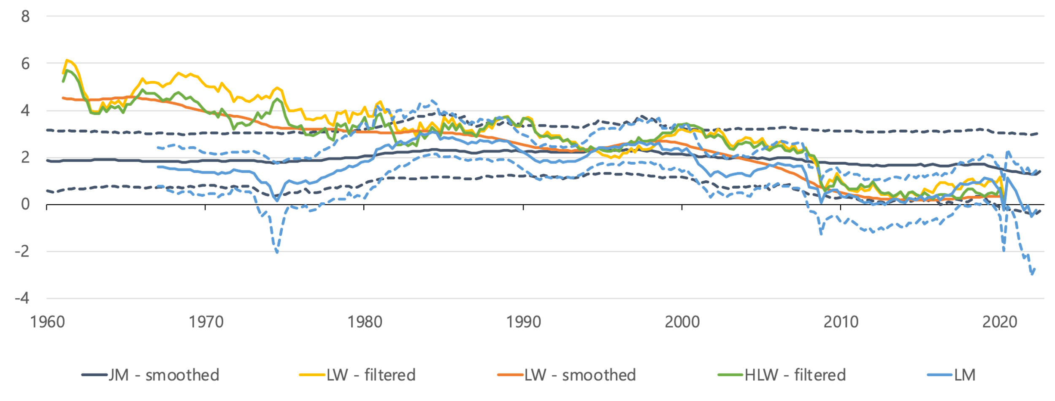
Estimates of the natural rate: both within and across model uncertainty
Estimates of r* for the US
(percentage points)

Slide 4
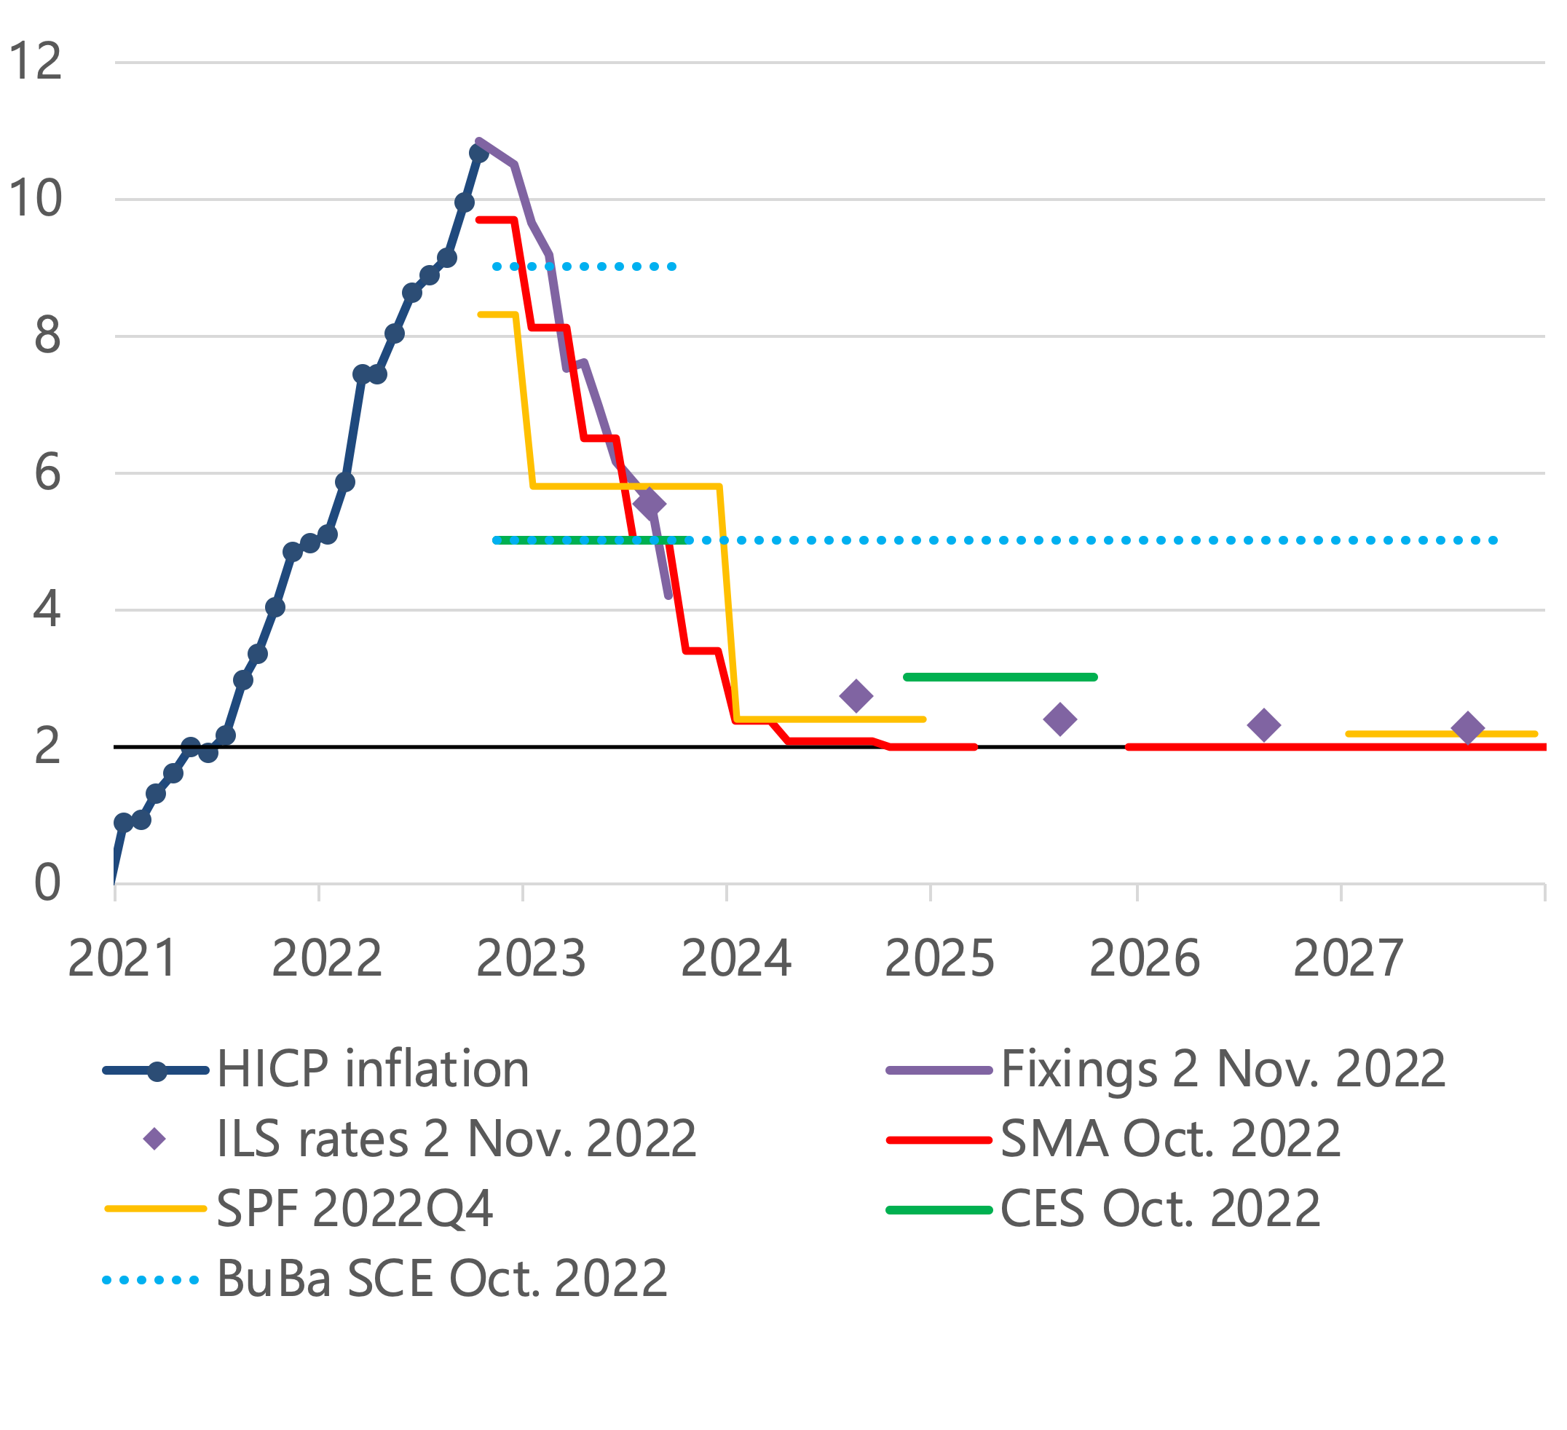
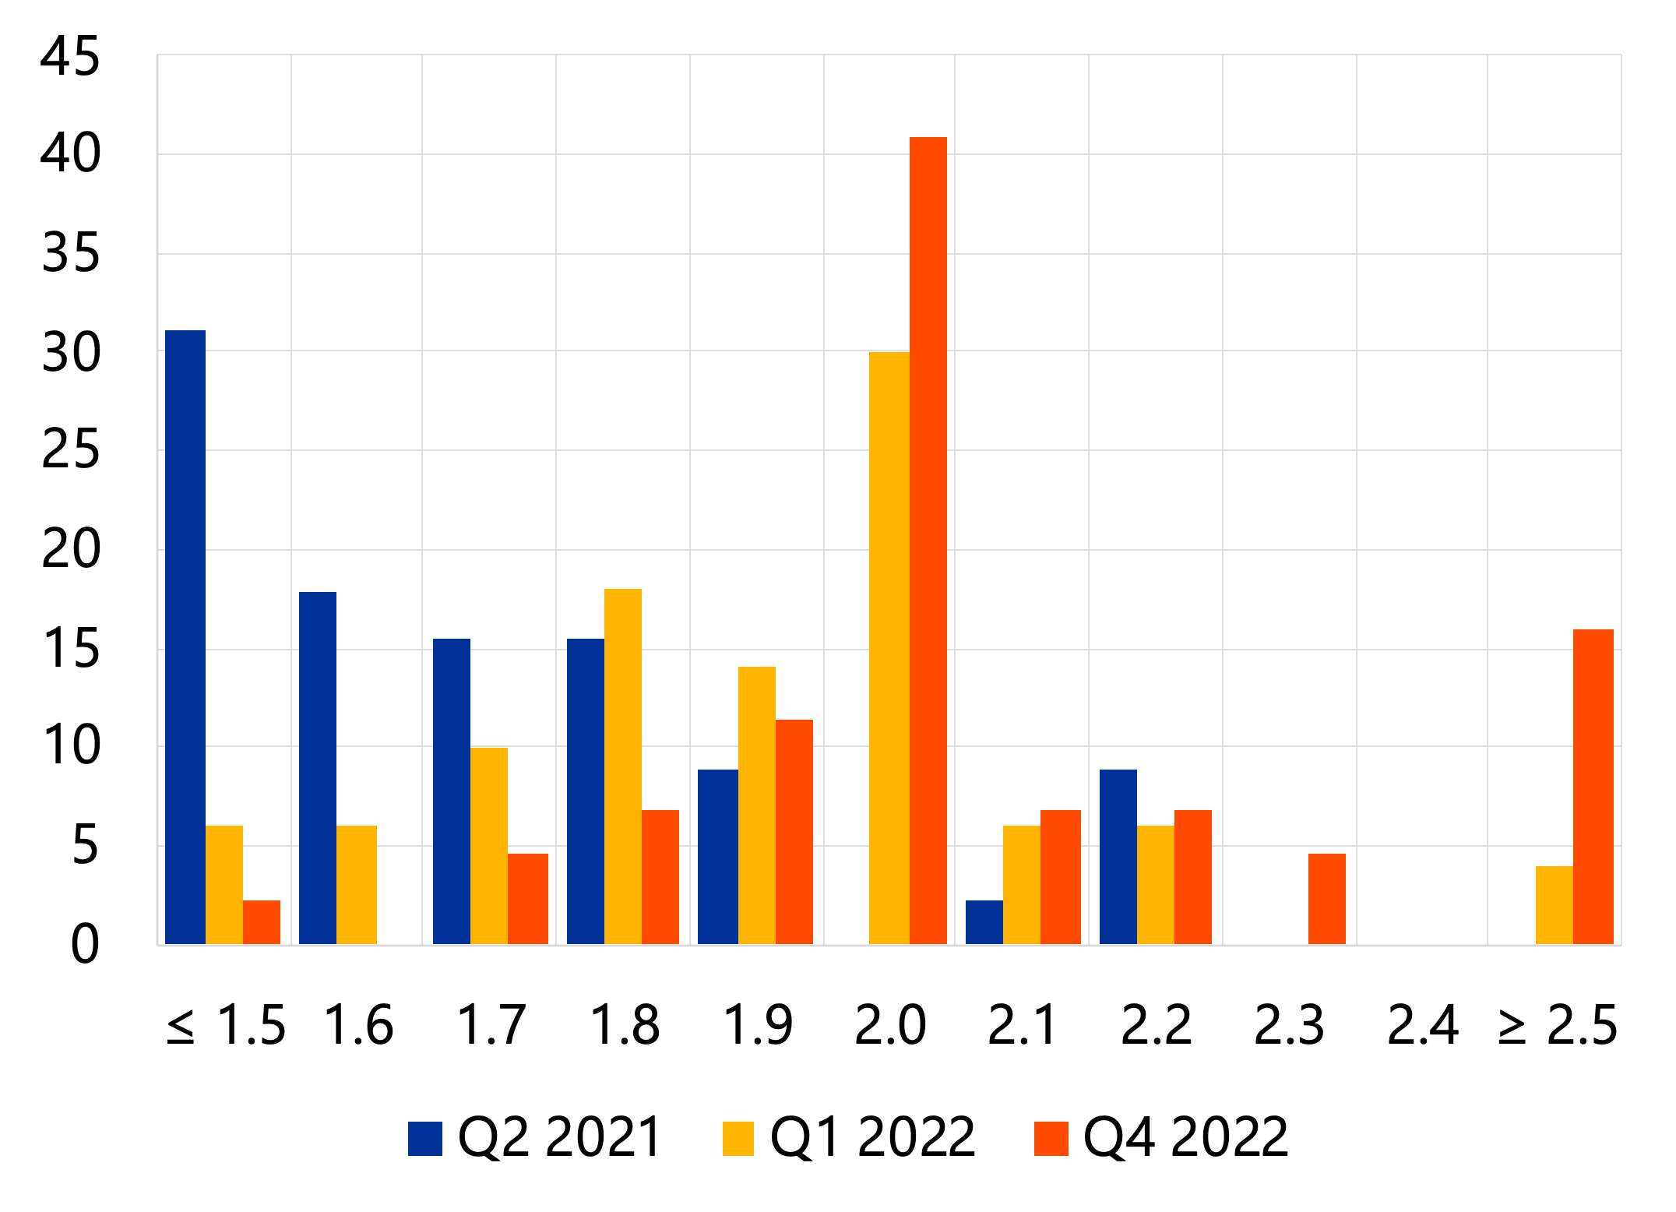
Anchored long-term inflation expectations, with some risks
Market and survey-based inflation expectations
(percentage points)
SPF distributions of long-term inflation expectations
(percentages)

Slide 5
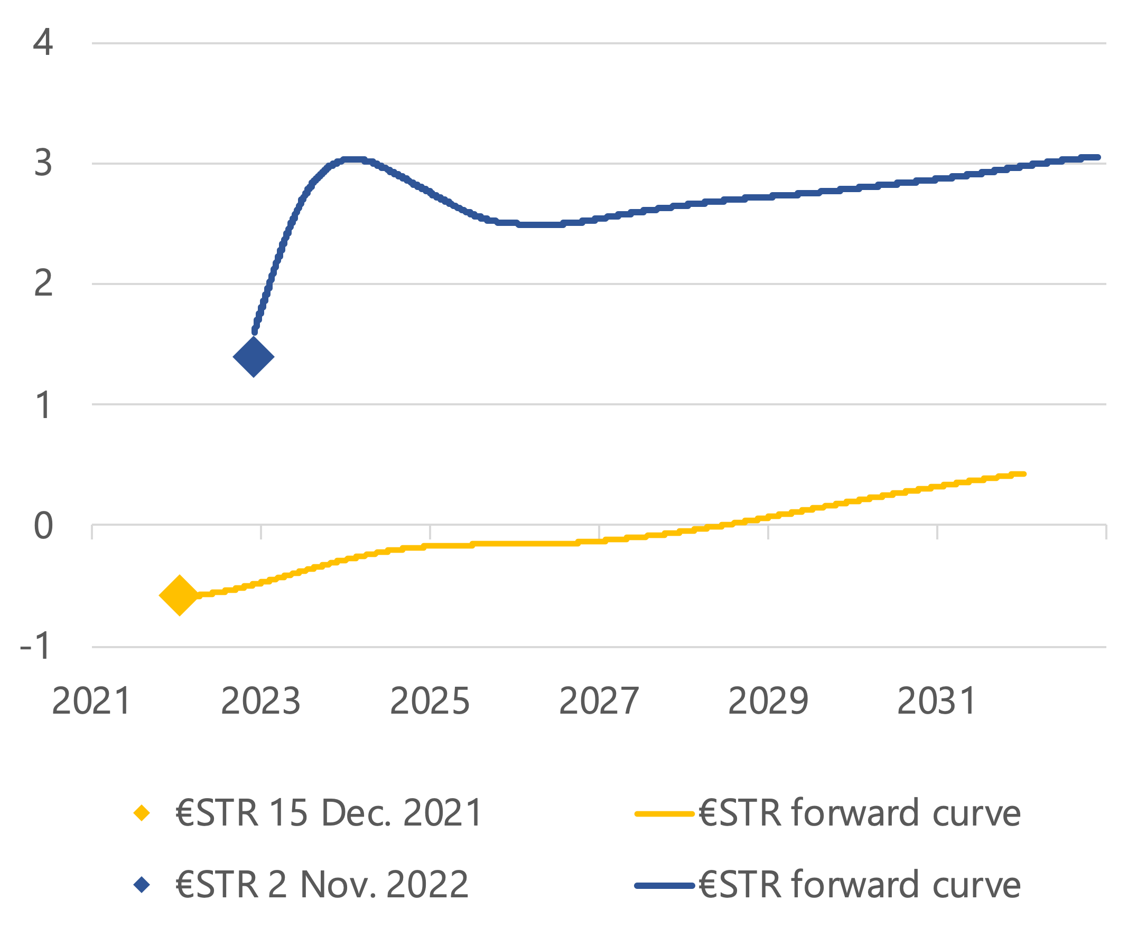
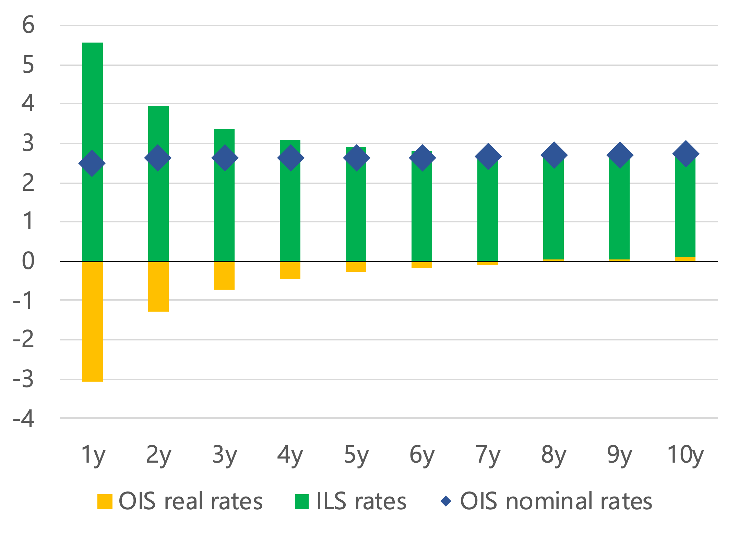
Repricing of €STR forward curve; up to 10-year real OIS rates still negative or zero
€STR forward curve
(percentage points)
OIS rates: nominal and real
(percentage points, 2 Nov. 2022)

